Slide 1
The Evolution of Dim Sum
Kaya Zamil
♥

Slide 2
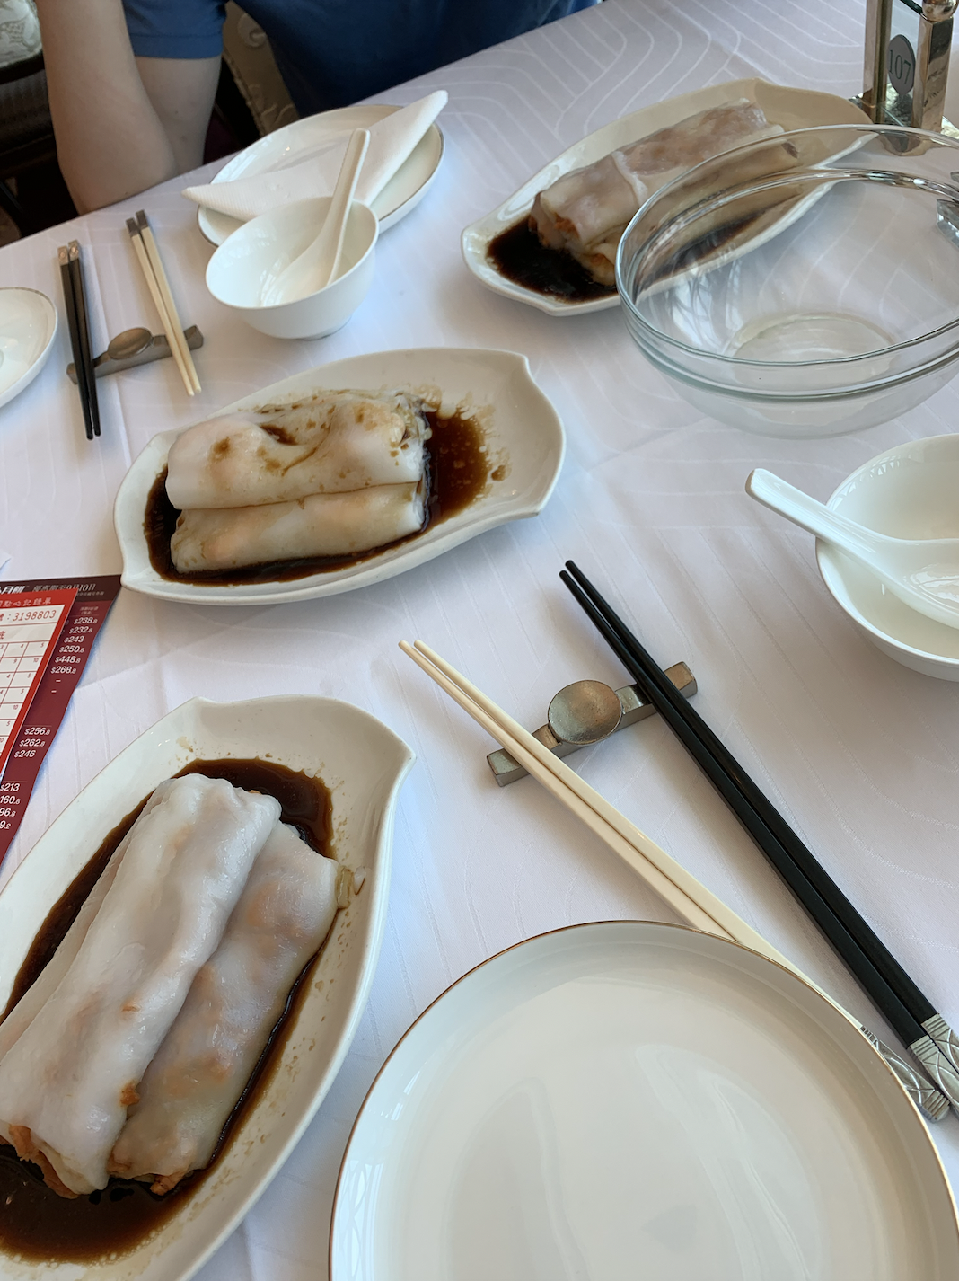
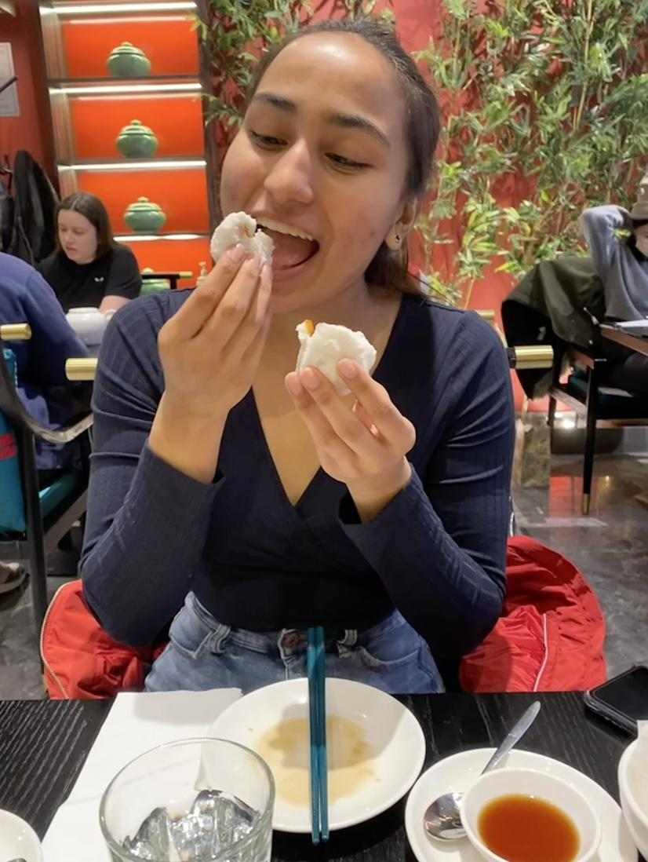
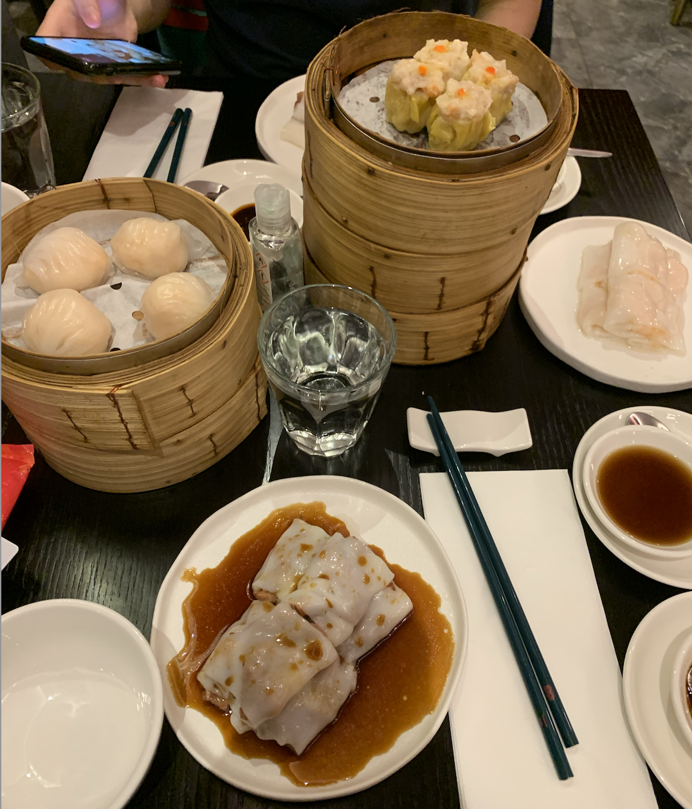
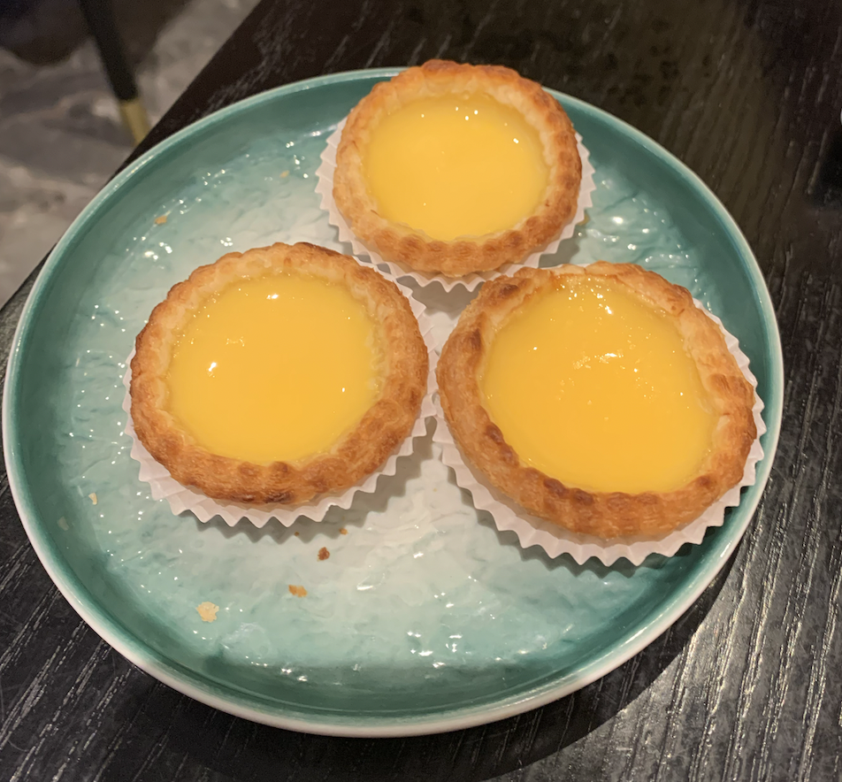
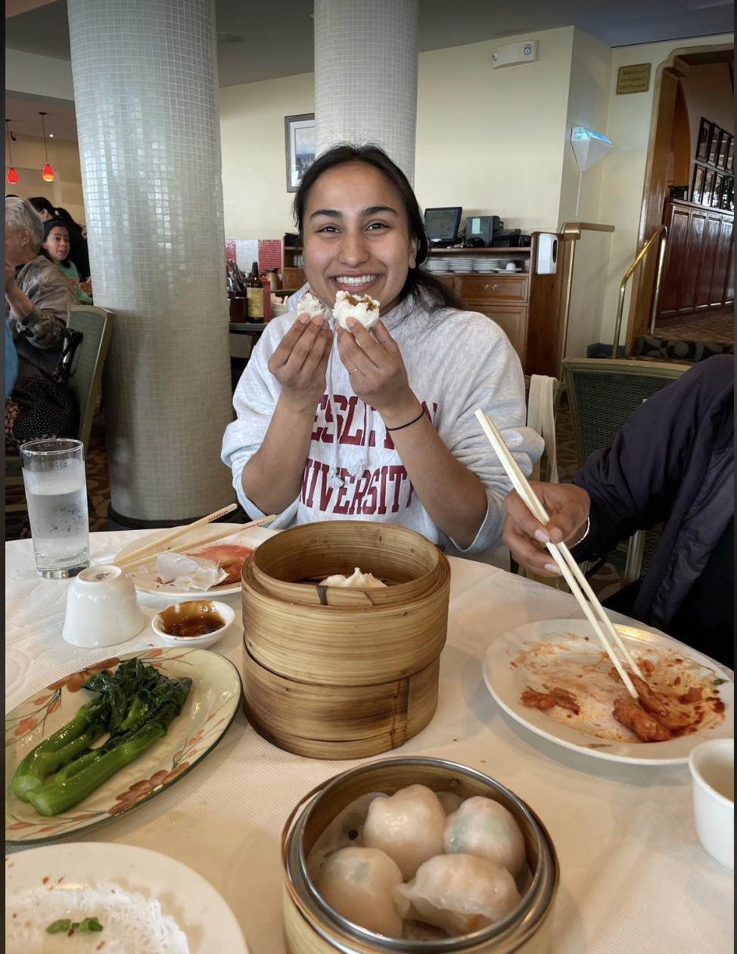
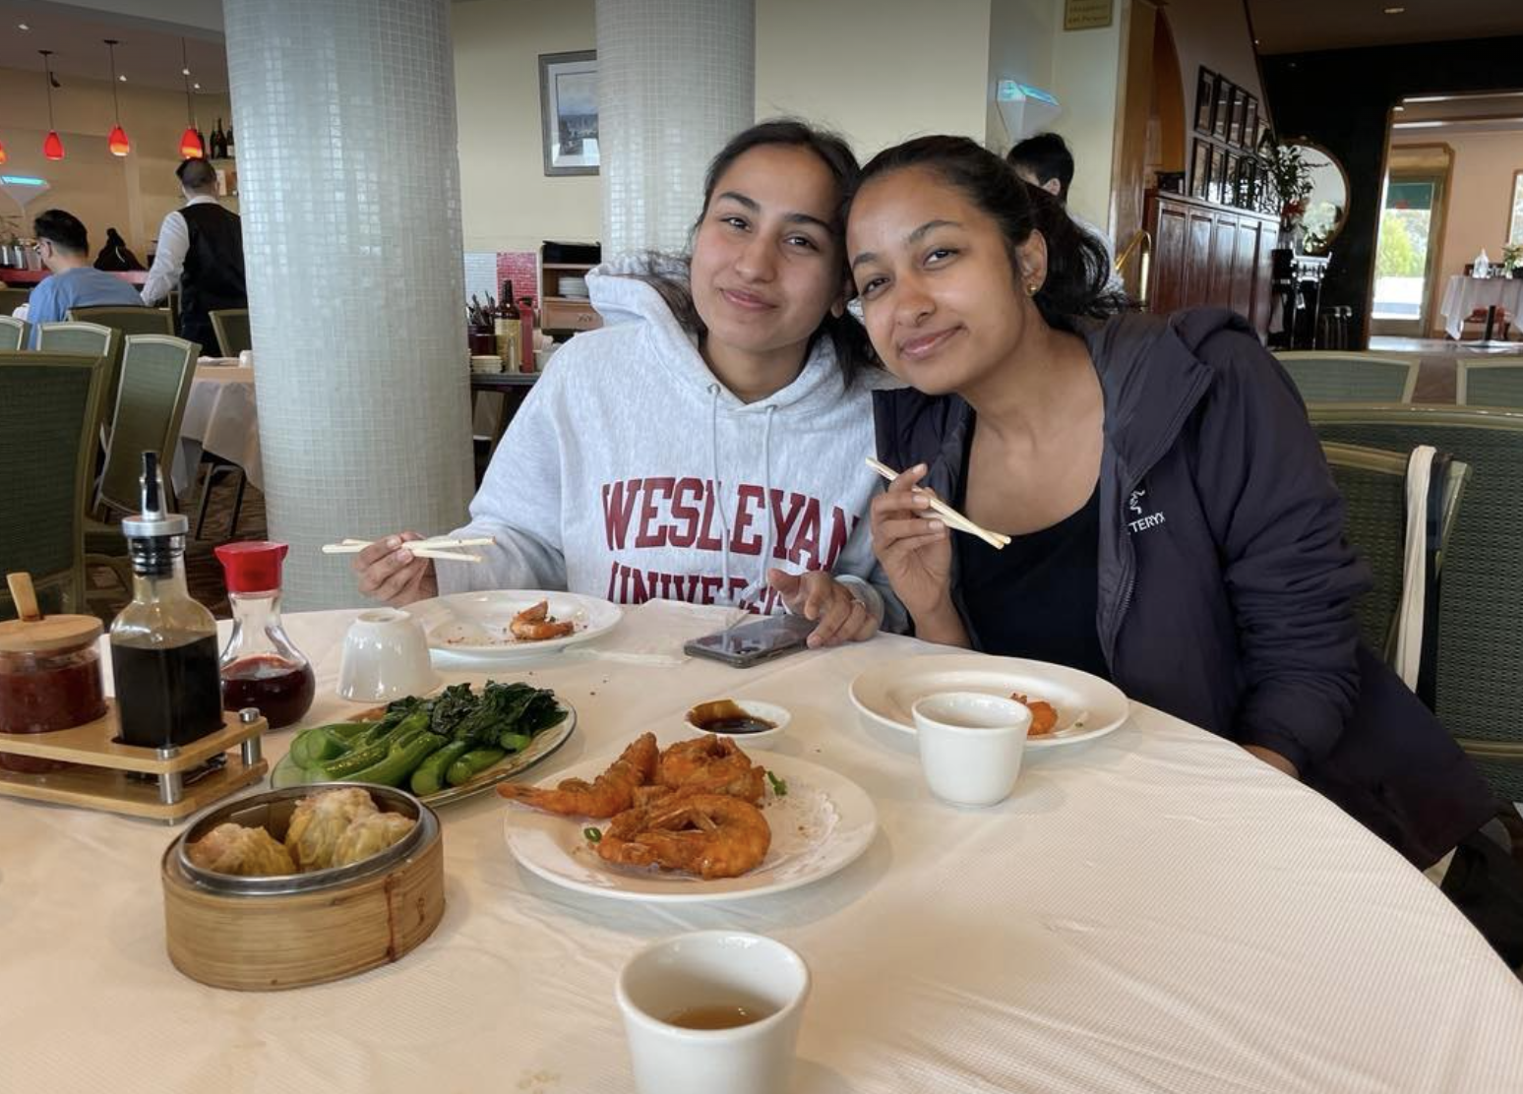
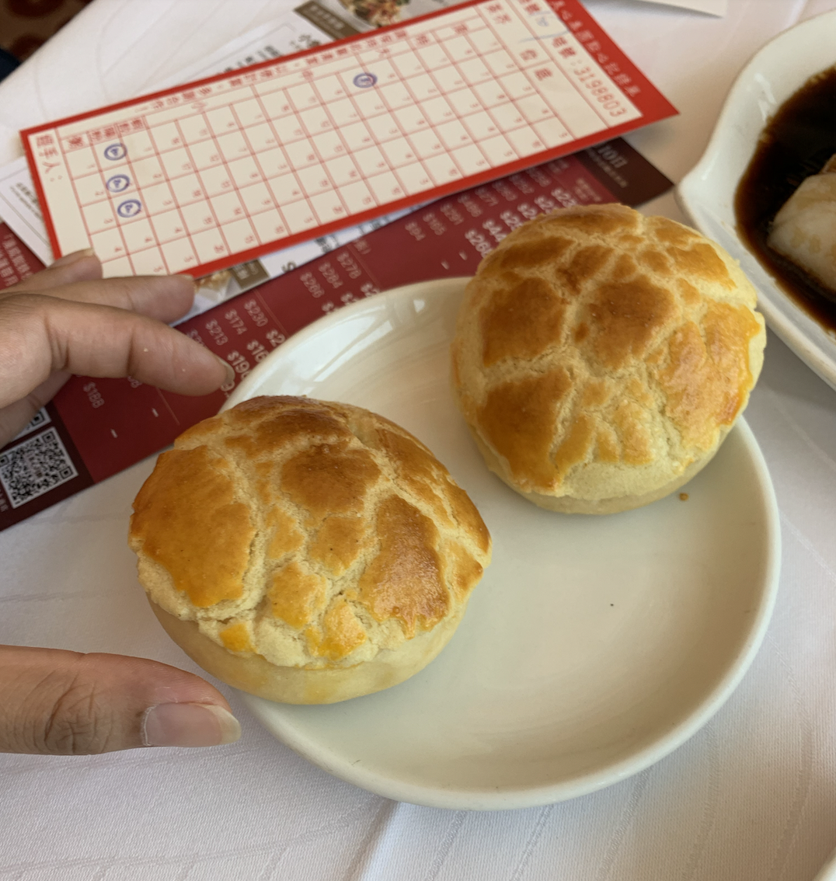
Personal Connection!

Slide 3
Dim Sum
Origins Diasporic Origins in the US
Originated in Guangdong in the Song Dynasty (960-1279 are the estimated dates)
Originally created as small snacks to have with tea, thus producing the name Yum Cha. Cantonese dim sum was first based on local street foods like char siu and cheung fan.
Dim Sum is served all days from as early as 5am - mid-day, typically the most popular day being Sunday brunch with family. Traditionally too, these will be sold on carts, a.k.a. “Cart Dim Sum”
Dim Sum has been traced back to the Gold Rush era in the mid 1800s when Chinese families first started immigrating into the US.
Canton Restaurant - SF, Yak Sing - SF, Hang Ah - SF, Nam Wah Tea Parlor - NY. These are some of the first Dim Sum restaurants in the United States (built around the 1900s-1920s) all contributing to the popularization of DIm Sum.
Geographic spread of Dim Sum hotspots in the US.
Notes:
The Chinese preferred to live in the present Chinatown area because of its restaurants and theatres.[120] In the late 1930s, some early U.S. newspaper references to dim sum began to appear. While some Chinese restaurants in the U.S. had offered dim sum for decades, it was not until the late 1980s that there was a broader public awareness of dim sum.
________________
Dim sum is a type of cuisine that originated in southern China, particularly in the Guangdong province. The origins of dim sum in the US can be traced back to the mid-1800s when Chinese immigrants began arriving in California during the Gold Rush era. As Chinese immigrants settled in the US, they brought with them their traditional foods, including dim sum.
Many Chinese immigrants who came to the US during this time were from the Guangdong province, where dim sum is a popular food. These immigrants opened restaurants and tea houses in cities such as San Francisco, Los Angeles, and New York, serving dim sum to both Chinese and non-Chinese customers.
Over time, dim sum became increasingly popular in the US, and many Americans began to associate it with Chinese cuisine. Today, dim sum is a popular food in many cities throughout the US, with many restaurants offering a wide variety of dim sum dishes.

Slide 4
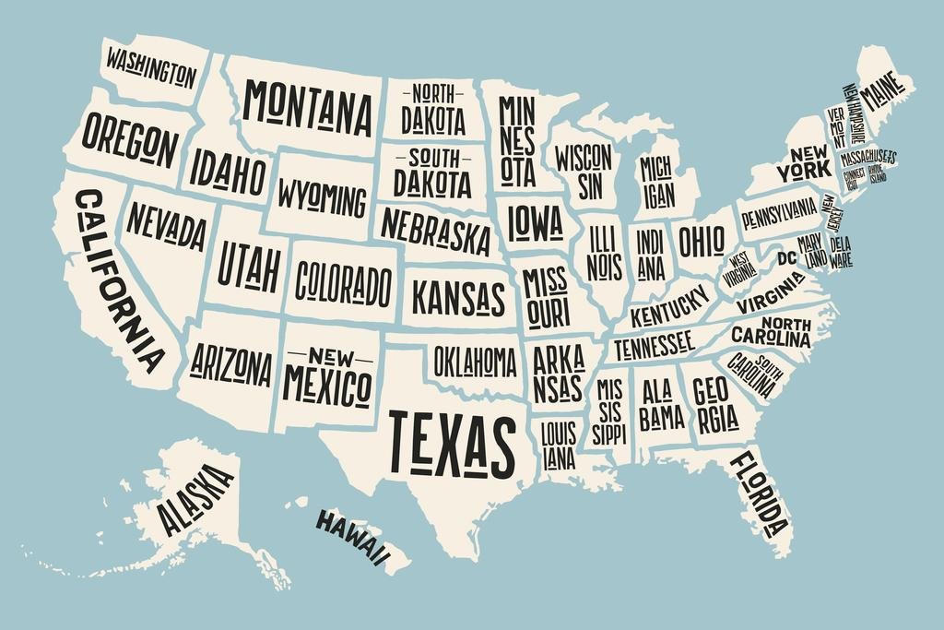
Geographic Spread of Dim Sum in the US
You’ll find mostly in California, New York, and Chicago the largest dim sum spots due to greater numbers of Chinese immigrants and families.
In the U.S. you may also see Dim Sum restaurants be referred to as “blob joints,” referring to the dumplings’ similarity to small blobs.

Slide 5
Authenticity of Dim Sum in the United States
01
02
03
04
05
06
VARIETY
INGREDIENTS
SERVICE
PORTIONS
TEXTURES
NEW ITEMS
Notes:
Cantonese menus for Dim Sum may have greater varieties than American ones, with more extensive lists of Dim Sum flavors, while American establishments sometimes only serve the more popular flavors.
Certain ingredients are more accessible in Hong Kong than they are in the US for example milk powder, sticky rice, pandan leaves, sago, lotus leaves, chicken feet, etc. as these ingredients are more common in Cantonese cooking than American ones. Now it may be more accessible than in the past, but it definitely does not compare to ingredient accessibility in HOng Kong.
Service in Hong Kong tends to be cart dim sum or checklist menus, so you’ll often hear what we call “cart ladies” yelling the sames of dim sum items, you flag them over, and request however many plates you’d like. This adds to the ambiance but defies polite behavior that is assumed in western restaurants, so in the US it is more common to see waiters take orders and bring the dishes directly to the table.
Portions are meant to be small as these were initially intended as snacks alongside tea, but in the United States we often see much larger portion sizes according to / to also suit the differences in appetites.
Textures and tastes can differ from the meat itself (more added salt in the US than Hong Kong), to the gumminess of the wrappers. You’ll find in many hong Kong establishments that har gau has a very thin wrapper around the shrimp, but in western dim sum chains, the wrapper tends to be much thicker due to either improper technique, lack of ingredients, or to accommodate to western taste buds and textures. You may also see that siu mai is typically shrimp and pork, but in the US it’s sometimes only pork.
But what is authentic? Yes this can differ from traditional dim sum offerings, but many of the popular items have still stayed the same too. There may be more to authenticity than just what is on the menu though, ambiance, taste and texture, all play a role. I would say this is authentic to American Dim Sum, and there may be some restaurants that are truly authentic to traditional Cantonese dim sum, but it in contextual on the place.

Slide 6
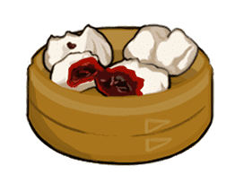
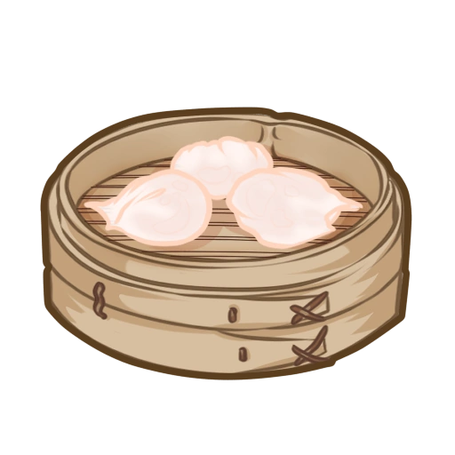
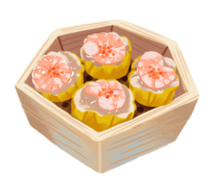
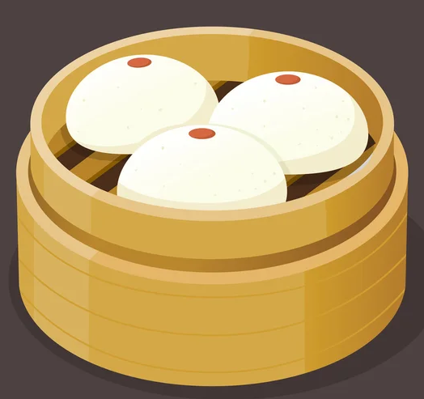
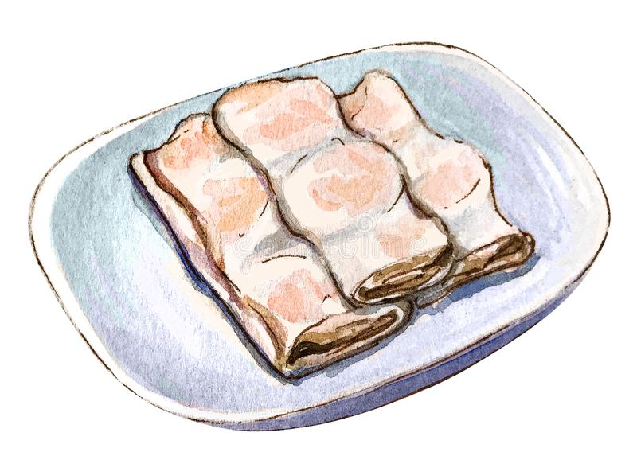
Popular Dim Sum Dishes
“Yum Cha”
Haa Gau | Shrimp Dumpling
Siu Mai | Pork and Shrimp Dumpling
Char siu bao | Char siu steamed bun
Cheung fan (char siu, haa) | Char siu / shrimp rice paper roll
Fung zau* | Steamed chicken feet
Ngau zap* | Beef entrails (pancreas, intestine, spleen, etc) in stock
Siu Long Bao | Pork Soup Dumpling
Lau sha bao* | Salted egg yolk bun
Law bat gao | Turnip Cake
Daahn Tāat | Egg Tarts
Ngauh Yuhk Yun | Steamed meatball
Dau fu fa* | Silky Tofu (rock sugar or ginger)
Mongo Sai Mai Lo* | Mango Sago
Crab Rangoon
Sweet and Sour Pork
General Tso’s Chicken
Fried Rice
Egg Rolls
Dim Sum With Alcohol

Slide 7
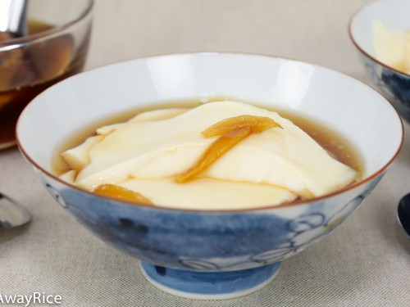
Popular Dim Sum Dishes
“Yum Cha”
Fung zaau* | Steamed chicken feet | Removed from menu
Ngaau zaap* | Beef entrails (pancreas, intestine, spleen, etc) in stock | Removed from menu
Liu sha bao* | Salted egg yolk bun | Chocolate bun
Do fu fa* | Silky Tofu (rock sugar or ginger) | Removed from menu
Daahn Tāat | Egg Tart | Removed from menu
Mongo Sai Mai Lo* | Mango Sago | Mango pudding, still traditional but offered as an alternative to mango sago
Notes:
Family tree!

Slide 8
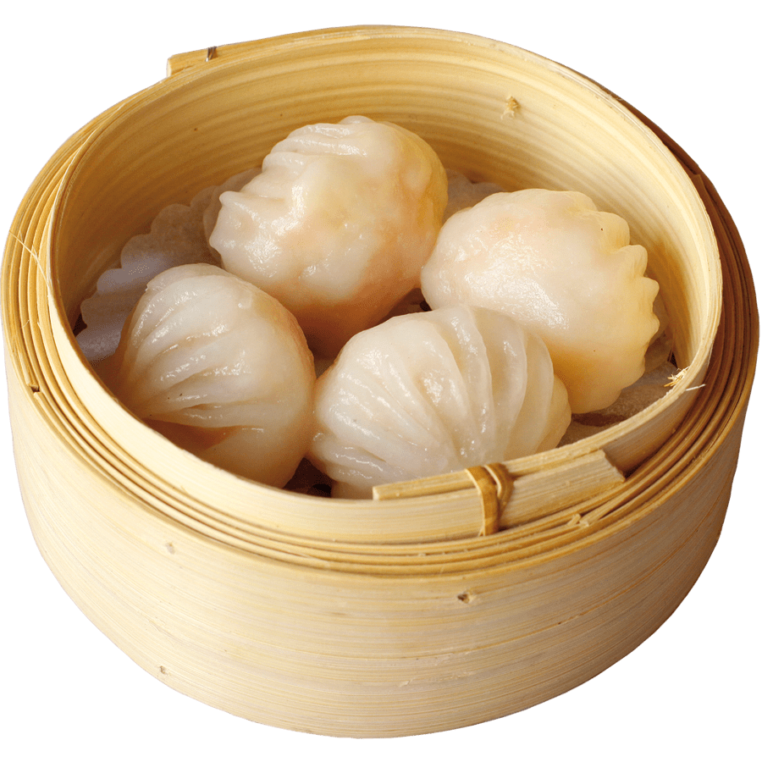
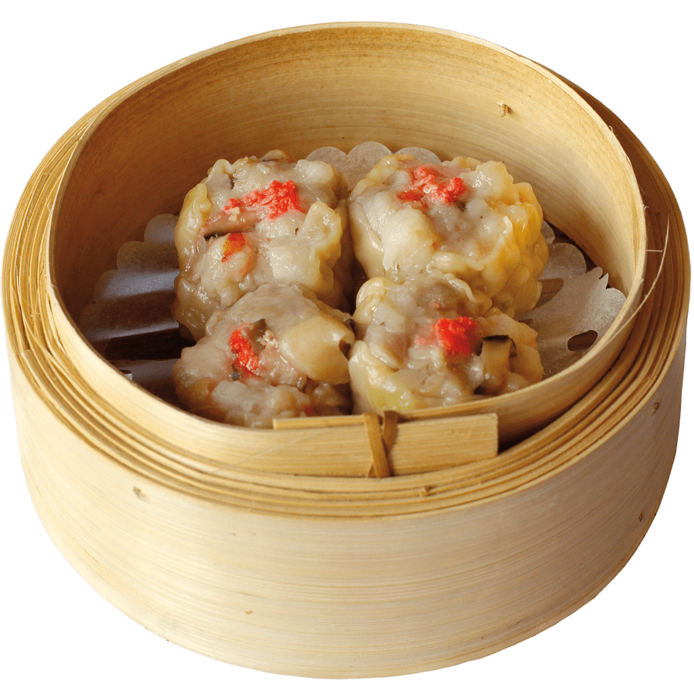
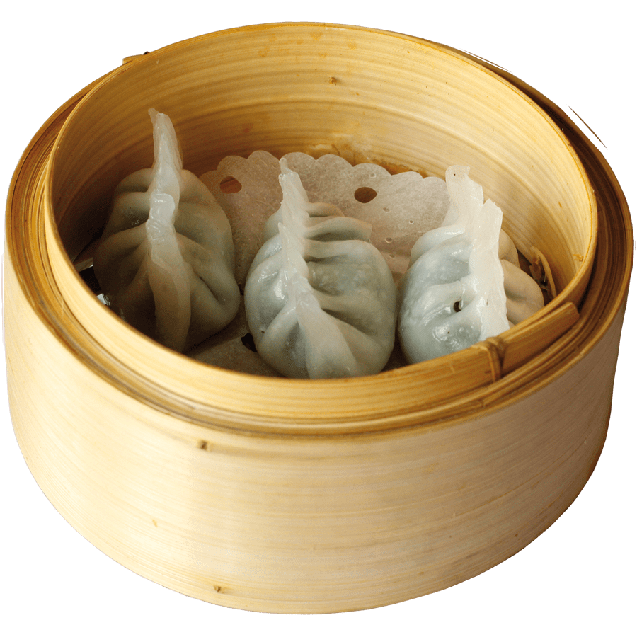
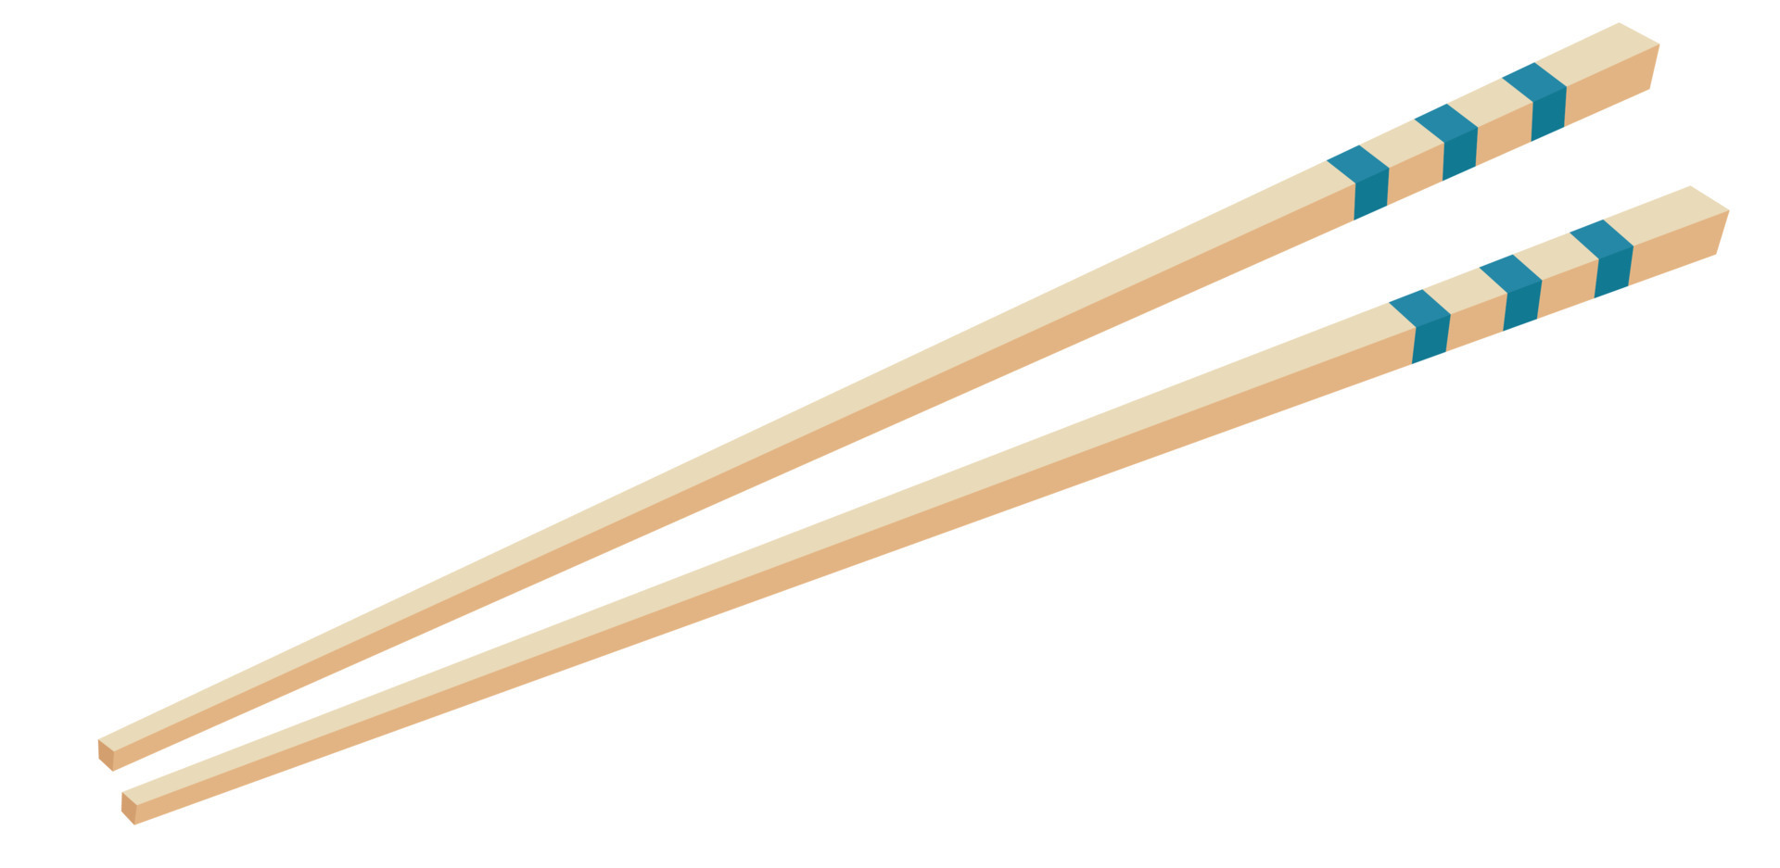
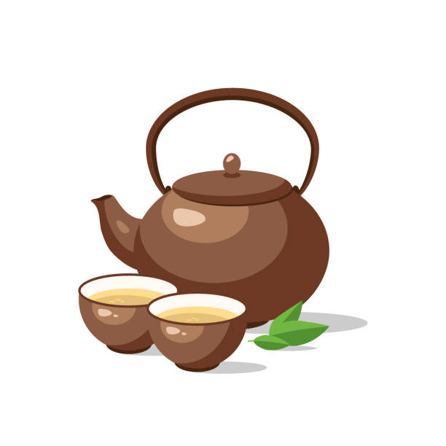
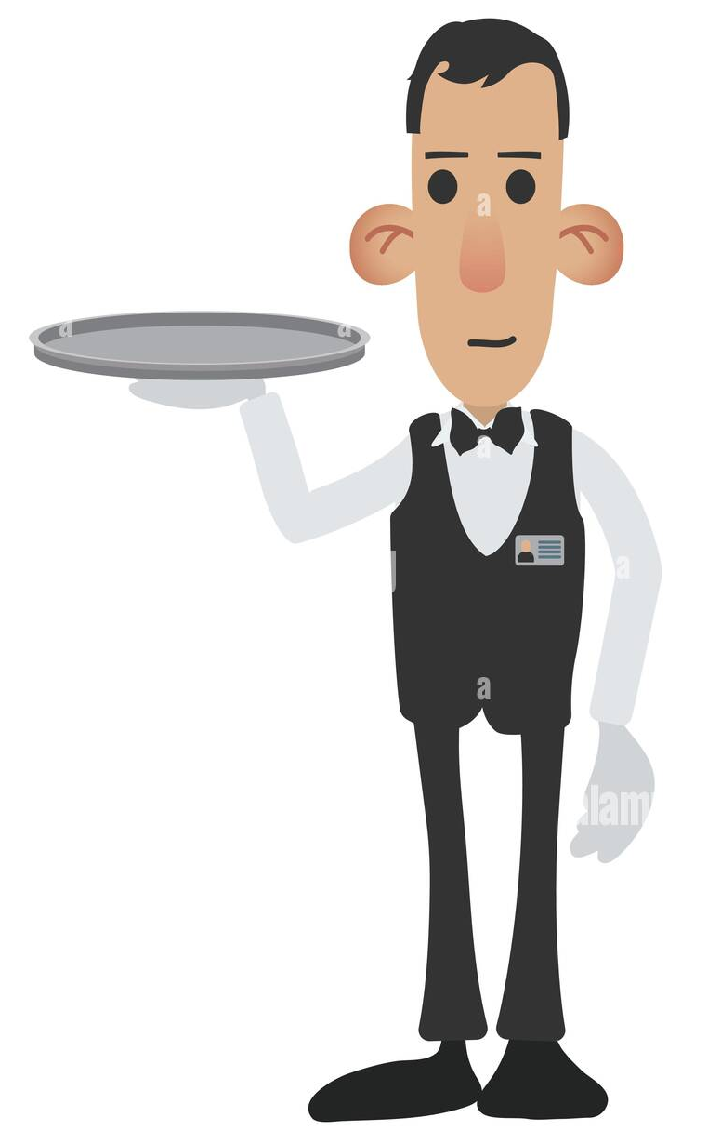
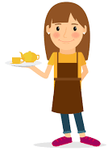
Dim Sum Etiquette
Chopsticks
Tea
Hierarchy
Thank yous
You’ll have two pairs of chopsticks, one for sharing plates and one for your personal plate.
Leave the teapot lid ajar for a refill.
You’ll see some women pushing cars, men in white, and men in suits. Your waiter will be the person who takes your drink order or ordering directly from a cart lady. Typically one will not place an order with a man in the suit as they hold a higher status.
To signify saying thank you, tap the table with your pointer and middle finger.

Slide 9
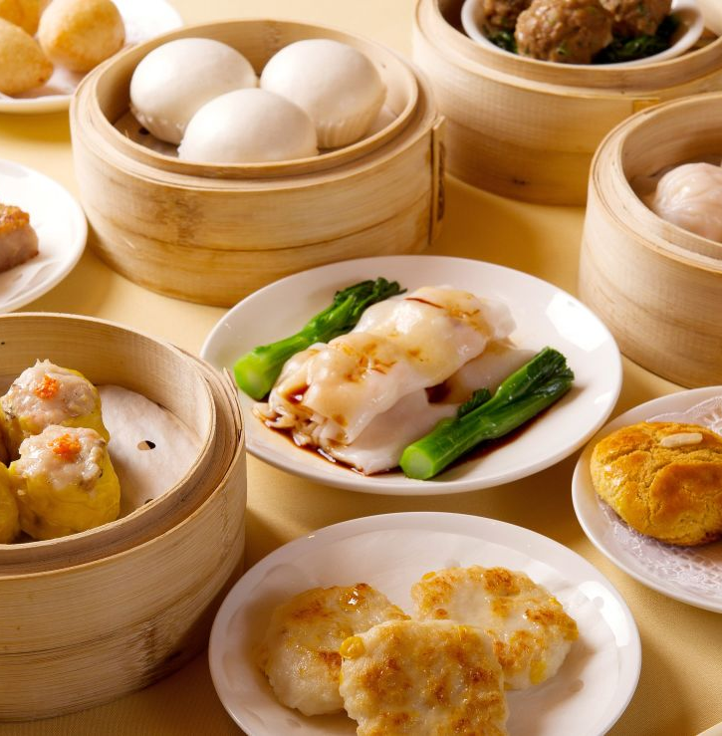
Dim Sum and Economic Features
In 2019, Census Data in Hong Kong reported that approximately 5.6% of the GDP originated from restaurants
No specific data on Dim Sum, but given that it’s a large part of Cantonese culture, it likely plays a significant role
According to the National Restaurant Association in the US, Chinese food is the third most popular cuisine
This industry employs approximately 300,000 people and accrues about $15 billion in sales per annum
Frozen Dim Sum in global markets is at an estimated $2.2 billion worth in 2020 and is anticipated to grow by 5.6% between 2021 and 2028
♥
Notes:
In Hong Kong, the restaurant industry is a significant part of the economy, and the dim sum industry is a significant part of the restaurant industry. According to data from the Hong Kong Census and Statistics Department, in 2019, the food and beverage sector (which includes restaurants) accounted for approximately 5.6% of Hong Kong's GDP. While there is no data specifically on the dim sum industry, it is estimated to employ tens of thousands of people and contribute significantly to the overall restaurant industry.
The growth of the restaurant industry in cities with large Chinese communities can be attributed in part to the popularity of dim sum. According to a report from the National Restaurant Association in the United States, Chinese food is the third most popular ethnic cuisine in the country, after Italian and Mexican. The report notes that Chinese restaurants in the United States employ more than 300,000 people and generate approximately $15 billion in sales annually.
The export of frozen and pre-packaged dim sum products has created new business opportunities for suppliers and manufacturers. According to a report from Research and Markets, the global market for frozen and pre-packaged dim sum products was valued at approximately $2.2 billion in 2020 and is expected to grow at a compound annual growth rate of 5.6% between 2021 and 2028.

Slide 10
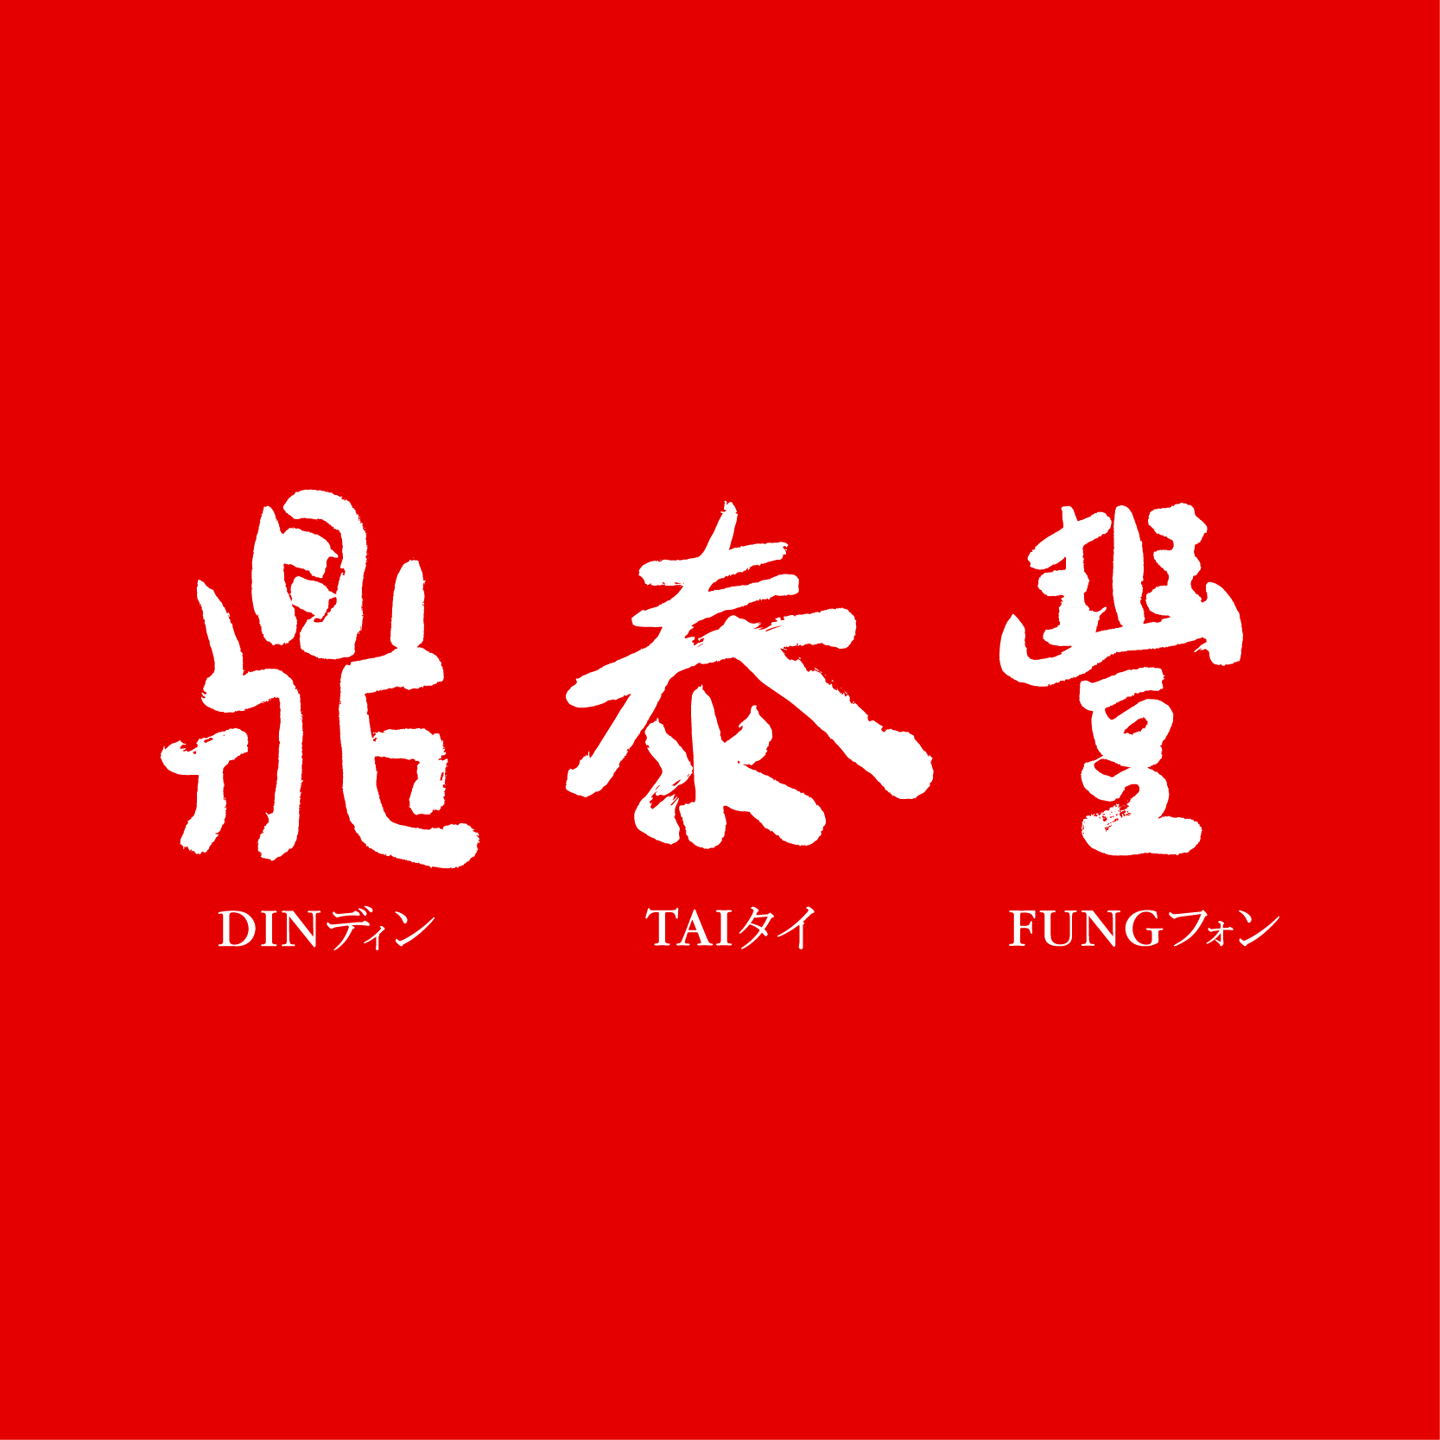
Din Tai Fung
♥

Slide 11
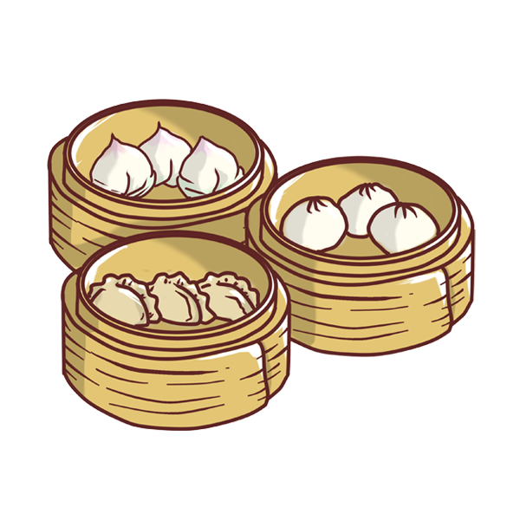
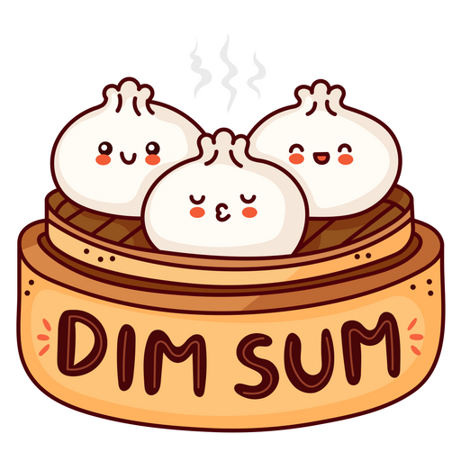
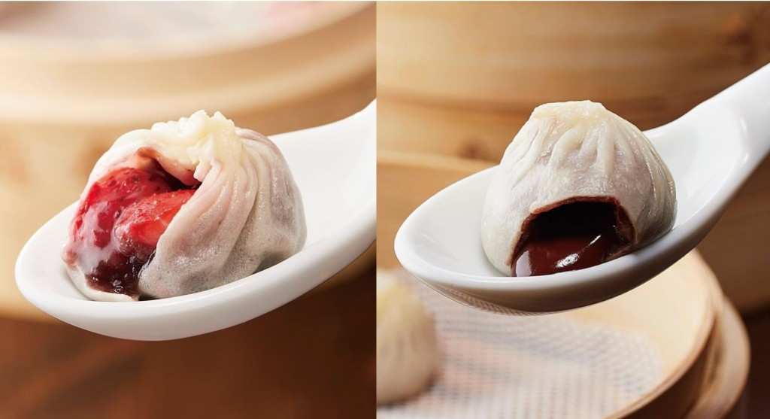
Din Tai Fung
USA
Taiwan
London
Hong Kong
Sweet and Sour Baby Back Ribs
Vegan Buns
Vegan Wontons
Cod Dumplings
Truffle and Pork Xiao Long Bao
Kimchi and Kurobuta Dumplings
Sticky rice and Kurobuta Siu Mai
Broccoli with Garlic
Mini Chocolate buns
Salted egg yolk custard buns
Sesame, taro, red bean buns & Xiao Long Bao (no mochi)
Truffle and pork Xiao Long Bao
Steamed Lamb Dumplings
Steamed Fish Dumplings
Bamboo Salad
Braised eggplant (cold)
Sweet and sour pork spareribs
Spicy beef tripe
Rice cake
Sweet soup
Honey and Vinegar Short Ribs
“Oriental” Salad in Vinegar Dressing
Truffle and Pork / Beef Xiao Long Bao
Salted egg yolk custard buns
Red bean Xiao Long Bao with Chocolate Lava
Deep fried fish w/ special sauce
Beancurd puff with black fungus
Shredded jellyfish with radish
Green squash and shrimp Xiao Long Bao
Black truffle and pork Xiao Long Bao
Sticky rice and pork Siu Mai
No chocolate bun offered, only red bean, taro, and sesame (as buns w/out mochi)
Salted egg yolk custard buns
Steamed rice cake
Sesame, Red Bean, Taro & Mochi Xiao Long Bao, Sweet Taro Bun, Chocolate Bun, Dan Dan Noodles / Sesame Noodles, Egg Fried Rice
Notes:
Typically see the egg fried rices in Cha chaan tengs

Slide 12
Asian American Social Identities and Dim Sum
CHICKEN FEET
RUDE
GOOD FOOD
In the US, there’s a common stereotype that Chinese people eat “weird” foods that seem unpalatable to Americanized tastes like chicken feet. So, foods like these presented in dim sum menus contribute to that perception of what it means to be Chinese, identifying Chinese individuals as “strange”.
Traditional cart Dim Sum necessitates a bustling environment, but also plays into American conceptions of rudeness. It’s considered as normal for cart ladies to yell orders and at customers in Hong Kong but in the US this is deemed rude. This plays into the social stereotype of Chinese people being blunt and rude.
In spite of these negative stereotypes that arise from the ambiance and types of food traditionally served in Dim Sum restaurants, Dim Sum has helped term Chinese food as one of the most liked and delicious cuisines in the United States with its unique flavors and textures. This now comes with the association of Chinese people and good food.

Slide 13
Asian American Political Identities and Dim Sum
CSWA - Chinese Staff and Workers Association
As of 2021, Jing Fong was the only dim sum restaurant to be unionized. Other unions that exist to support restaurants and businesses in Chinatown are unionized under CSWA.
Founded in 1979 in NYC. Landmark accomplishments of the CSWA:
In 1986, they prevented luxury condos from being built because they would displace people and put them out of business.
In 2006, it was said that employers could no longer charge a service charge in replacement of tips for staff.
In 2015, tipped employees received a raise in minimum wage ($8.65 USD to $10 USD, and with tip credit, it guarantees $15 an hour)

Slide 14
References
Adams, E. (2021, February 26). Jing Fong's unionized workers protest upcoming dining room closure. Eater NY. Retrieved April 18, 2023, from https://ny.eater.com/2021/2/26/22300941/jing-fong-workers-union-protest
Auffrey, R. (2021, March 5). Blob joints: A history of dim sum in the U.S. Sampan. Retrieved April 18, 2023, from https://sampan.org/2021/food/blob-joints-a-history-of-dim-sum-in-the-u-s/
Chow, R. (n.d.). The provocation of Dim Sum; making diaspora visible on film. Scholars@Duke. Retrieved April 18, 2023, from https://scholars.duke.edu/display/pub1010101
Dow Jones & Company. (2016, November 25). Dim Sum: The delicious diaspora. The Wall Street Journal. Retrieved April 18, 2023, from https://www.wsj.com/articles/dim-sum-the-delicious-diaspora-1480104768
Epicurious. (n.d.). Dim Sum etiquette - chinese/lunar new year. Epicurious. Retrieved April 18, 2023, from https://www.epicurious.com/archive/holidays/lunarnewyear/dim-sum
Hong Kong Food Census Data. Statistics - by subject. (n.d.). Retrieved April 18, 2023, from https://www.censtatd.gov.hk/en/page_8000.html?productCode=B1130001
Hua, V. (2015, April 6). The Dim Sum Revolution. SFGATE. Retrieved April 18, 2023, from https://www.sfgate.com/living/article/The-dim-sum-revolution-6177566.php
Lee, A. (n.d.). Dim Sum and the Chinese diaspora. Chapman University Digital Commons. Retrieved April 18, 2023, from https://digitalcommons.chapman.edu/cusrd_abstracts/404/
Surewicz, A. (2023, February 2). The untold truth of dim sum. Mashed. Retrieved April 18, 2023, from https://www.mashed.com/730414/the-untold-truth-of-dim-sum/
What is Dim Sum? the beginner's guide to south China's traditional brunch meal. Asia Society. (n.d.). Retrieved April 18, 2023, from https://asiasociety.org/reference/what-dim-sum-beginners-guide-south-chinas-traditional-brunch-meal
Worldwide, G. L. P. (n.d.). A guide to dim sum etiquette. A Guide To Dim Sum Etiquette. Retrieved April 18, 2023, from https://blog.glpworldwide.com/a-guide-to-dim-sum-etiquette
Zhou, N. (n.d.). Touch the heart with Dim Sum. The Science Survey. Retrieved April 18, 2023, from https://thesciencesurvey.com/arts-entertainment/2022/03/16/touch-the-heart-with-dim-sum/

