Slide 1
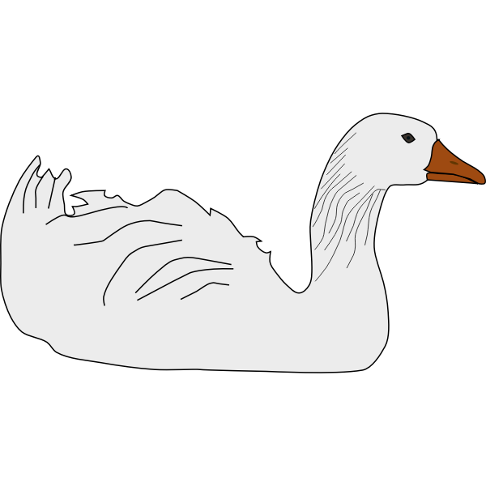
Peking Duck
By Henrick Koo

Slide 2
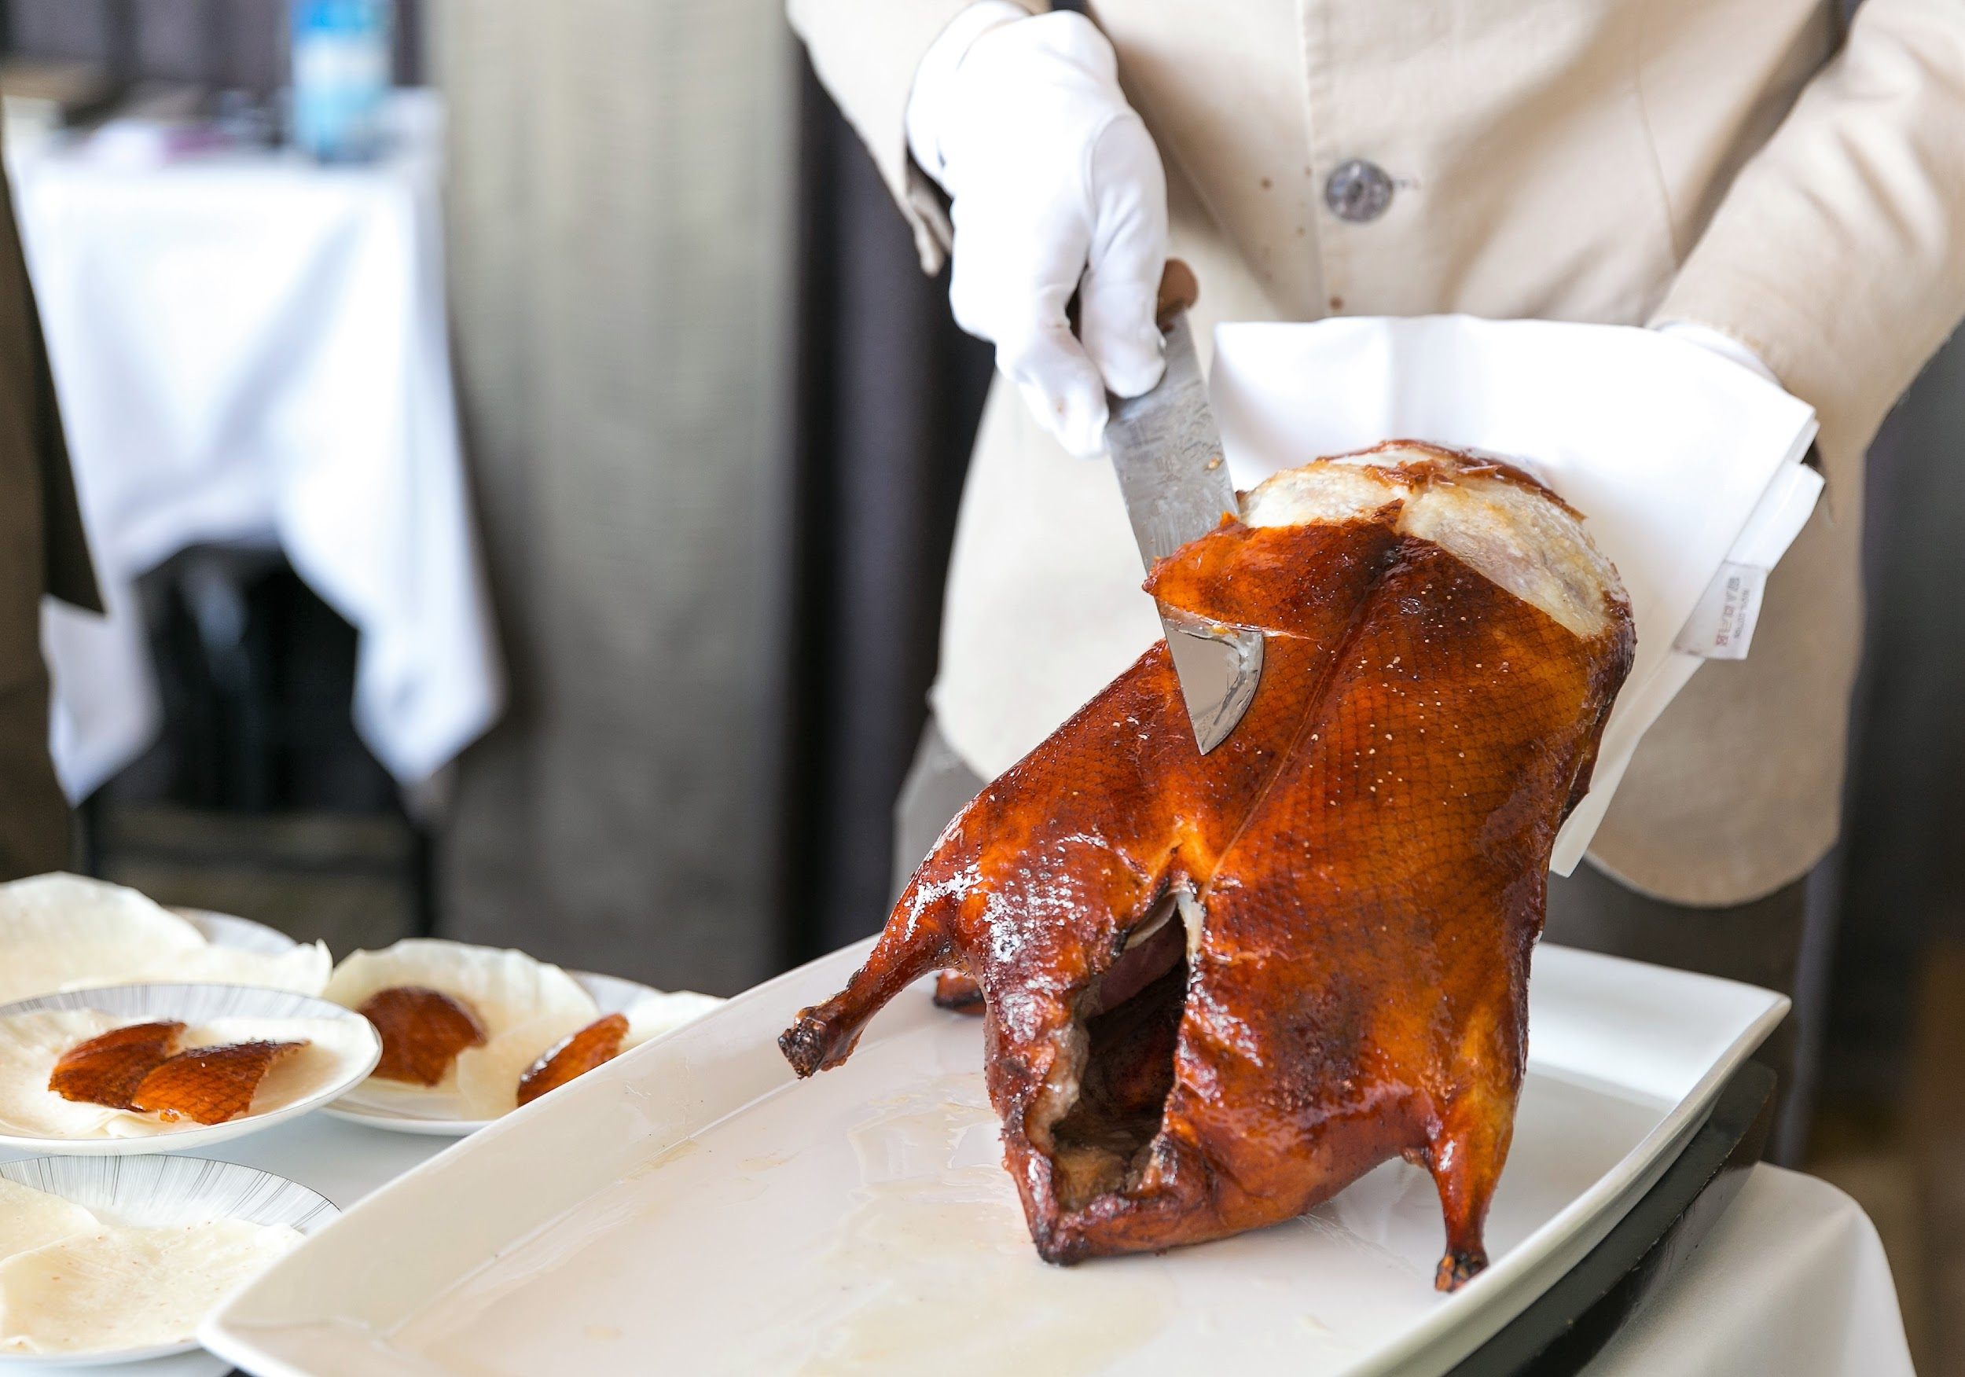
CONTENTS
History
American Integration
Consumption

Slide 3
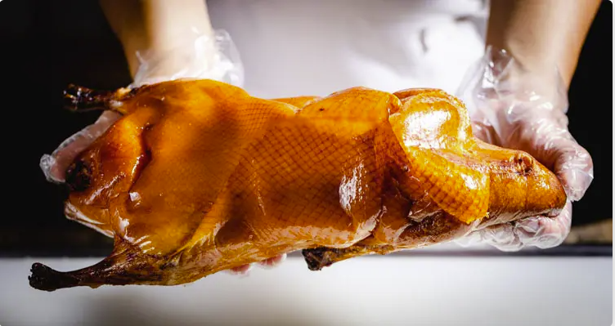
1
History

Slide 4
Origin
Origin
Evidence of preparing roasted duck in China goes back to Southern and Northern dynasties (420-589).
Yuan dynasty (1271-1368) first recorded association to the imperial court in the form of a cookbook
keyword
keyword
keyword
Hu Sihui, a royal dietary physician, had an elaborate preparation, including where the duck was roasted inside sheep stomach
Notes:
Evidence of preparing roasted duck in China goes as far back as the Southern and Northern dynasties (420-589).
However, it wasn’t until the Yuan dynasty (1271-1368) that the dish’s association with the imperial court was first recorded, in the form of a 1330 cookbook by a royal dietary physician by the name of Hu Sihui.
Hu’s recipe called for a rather elaborate preparation, where the duck was roasted inside the stomach of a sheep

Slide 5
Traditional Recipe
Origin
Peking duck is a succulent, crisp-skinned creation made by pumping air under the skin of the duck, which helps the fat render out more completely when it’s roasted, leaving incredibly crispy skin in its wake.
The bird is hung to dry overnight and coated in a sweet syrup and spices before it’s cooked in an oven, ideally over fruit wood.
keyword
keyword
keyword
The next slides will show the 2 main methods of cooking it in its final stage
Notes:
Peking duck (sometimes called Beijing duck in China), is a succulent, crisp-skinned creation made by pumping air under the skin of the duck, which helps the fat render out more completely when it’s roasted, leaving incredibly crispy skin in its wake. The bird is hung to dry overnight and coated in a sweet syrup and spices before it’s cooked in an oven, ideally over fruit wood.

Slide 6
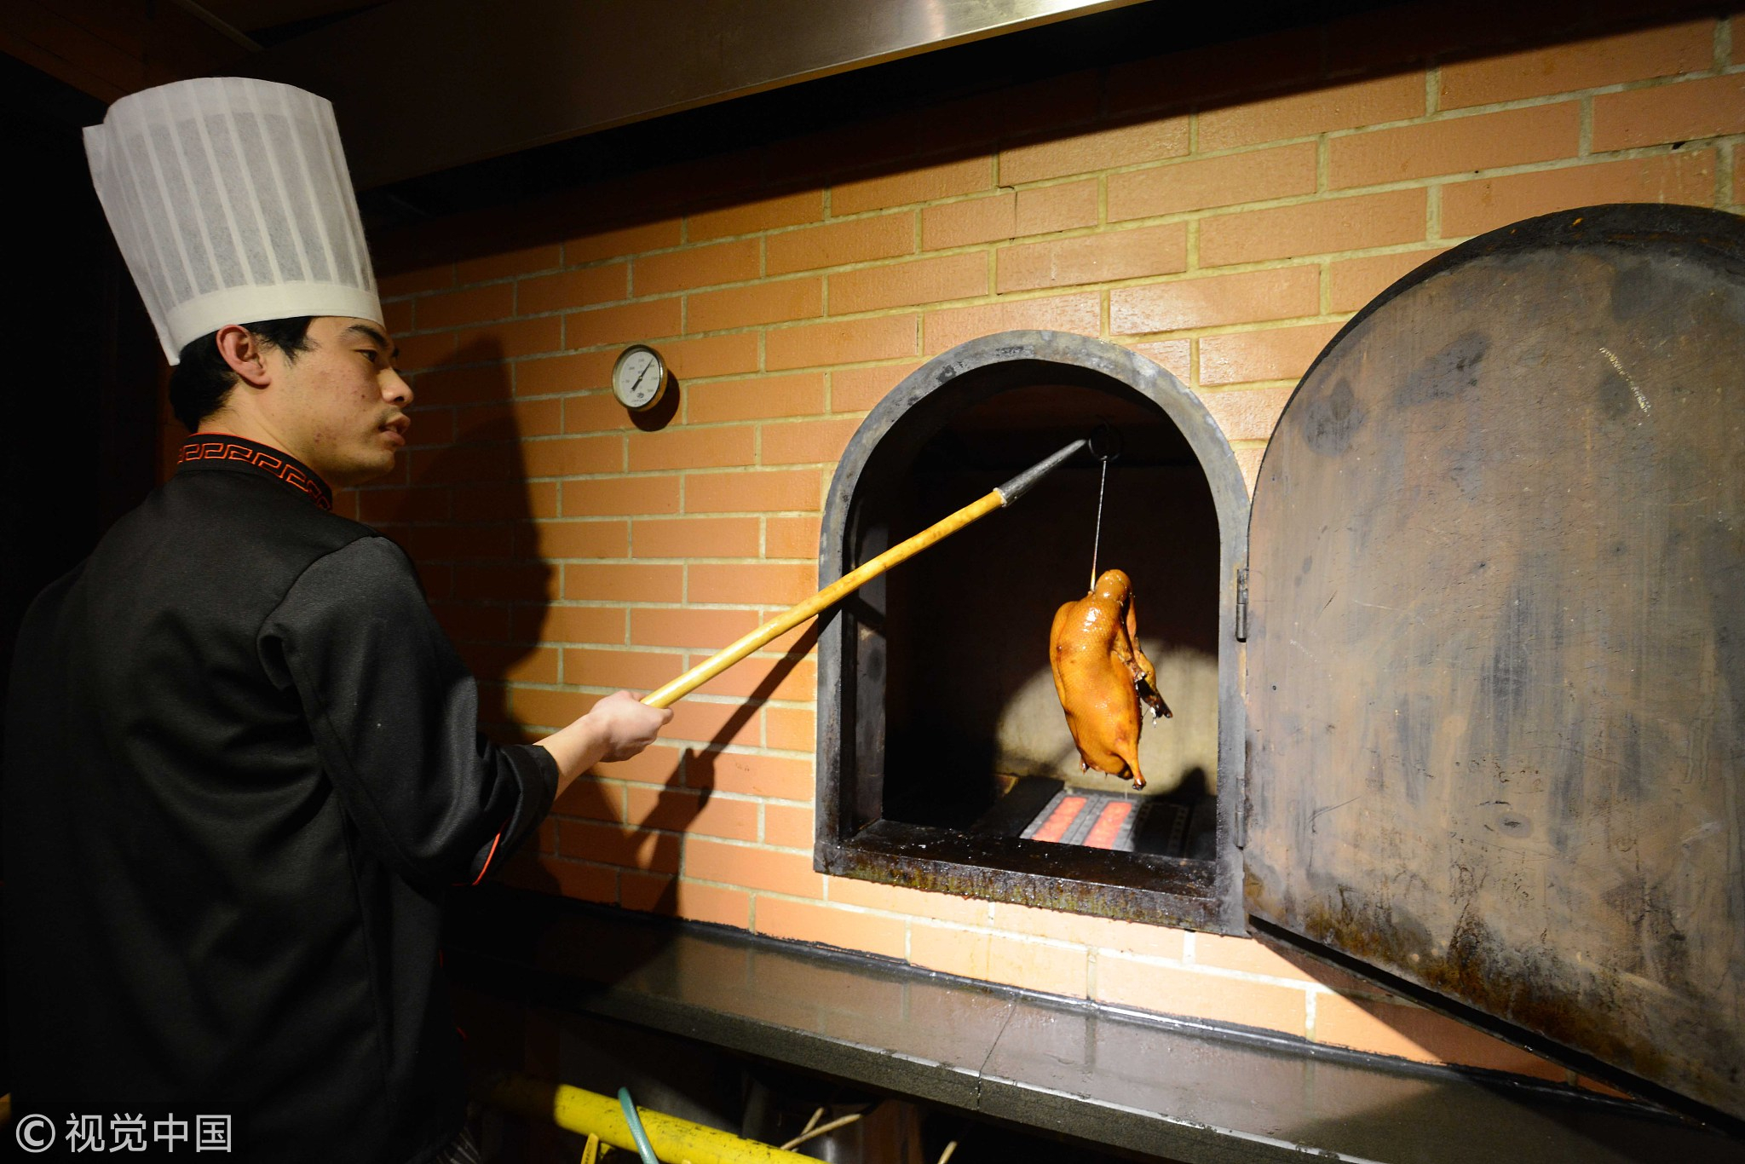
Traditional Recipes Cont.
Closed Oven
Ducks are roasted duck in a closed oven having first heated the walls of the oven using sorghum stalks
Creating a crispy finish to the duck
Bianyifang, 1416, first know restaurant to specialize
Notes:
In 1416, the first known restaurant to specialize in roast duck opened in Beijing, called Bianyifang.
There they roasted the duck in a closed oven having first heated the walls of the oven using sorghum stalks to give a crispy finish to the duck

Slide 7
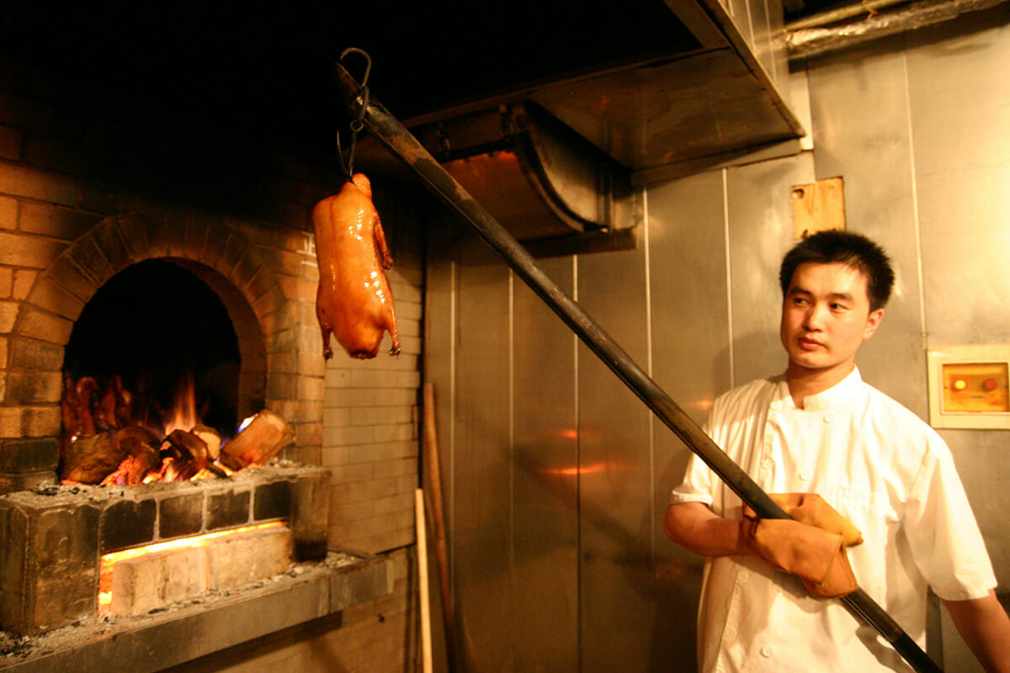
Traditional Recipes Cont.
Hung Technique
The ducks are hung to be roasted over flames in an open brick oven
Quanjude, 1864, the modern Peking duck “Chain” restaurant
Notes:
In 1864, another famous duck restaurant opened, called Quanjude. There they used a different method of cooking: hanging the duck to roast over flames in an open brick oven

Slide 8
2
Integration
to USA

Slide 9
Chinese Immigrants (The Shift)
Originally high-end
Duck Breed
Transcended as a renowned gourmet dish served in palaces, great households…
Otto Reichardt, Sr. supplied White Imperial Peking Ducks to San Francisco Restaurants since 1901
Diplomat’s Chefs
Chinese Cuisine Transition
Chef’s like C.M. Loo, were one of many high skills chefs that stayed in US and opened upscale Chinese restaurant
Cold War sparked shift in Chinese restaurants -> Kan’s and Mandarin
Notes:
Peking duck, a specialty from northern China, made it onto the menus of high-end Chinese-American restaurants early on. “Long before it was served in America, it had transcended purely regional status and was one of the renowned gourmet dishes that professional chefs in palaces or great households in all wealthy cities would have learned to prepare for formal banquets
It wasn’t until after WWII that Peking duck became a more common sight on Chinese restaurant menus. This was facilitated in large part by the arrival of diplomats representing Mainland China in New York City and Washington D.C., who came with household staffs that included highly skilled cooks. Many of those domestic workers went on to open upscale Chinese restaurants. One of them, The Peking Restaurant in D.C., was founded by C.M. Loo, a former Chinese diplomat’s chef, in 1947.
A search of the New York Times archives shows a spike in mentions of Peking duck in the ’60s and ’70s, due in large part to the attention dining editor and critic Craig Claiborne was paying to the new breed of Chinese restaurants. It seems that he sampled Peking duck at nearly every Chinese restaurant he reviewed, of which, by his own admission, there were many. He even ran his own recipe for it in 1971. “It was then that U.S. gourmets decided Cantonese cooking was old hat and the style associated with Mandarin-speaking Northerners was real Chinese cuisine,” says Mendelson.
duck farmer Otto Reichardt, Sr. had been supplying White Imperial Peking ducks, bred and raised specifically for the dish, to San Francisco restaurants since 1901
The Cold War ushered in a new era of Chinese restaurants in the United States. Restaurants got fancier, served non-Cantonese food, and charged much more money than the chop suey houses that came before. Legendary San Francisco establishments like Kan’s and Mandarin by Cecilia Chiang opened around this time, and were frequented by celebs and other well-heeled regulars

Slide 10
American Popularity
Authentic Chinese food garnered attention during the Nixon and Bush presidency during trips abroad
1
Constant media attention allowed the president's diet to be shown on National TV, leading to a wave of Chinese popularity
2
Trends like eating with chopsticks and the desire to eat more authentic chinese rippled through the US because of the media coverage
3
Reasons
More authentic dishes were introduced to the Chinese food scene in the US “authentic” dishes like Peking duck, Moo Shu pork, and sweet and sour fish were in popular demand.
3.5
4
The back-to-back presidency visits and especially President Bush’s liking of Peking Duck made it a huge item in chinese restaurants across America
Notes:
authentic Chinese food garnered attention during the Nixon and Bush presidency when they both went to China in hopes of improving relations with the country.
Since there was so much media attention and specific attention on Nixon’s diet during his stay in China, a wave of Chinese popularity swept through the US
Thanks to President Nixon that brought on an increased use in traditional Chinese ingredients, eating with chopsticks, and so on.
More authentic dishes were subsequently brought to the US as well, though you could say that Chinese immigrants were already opening restaurants and the more “authentic” dishes like Peking duck, Moo Shu pork, and sweet and sour fish were in popular demand.
The back-to-back presidency visits and especially President Bush’s liking of Peking Duck made it a huge item in the US and was in popular demand amongst the Chinese restaurants.

Slide 11
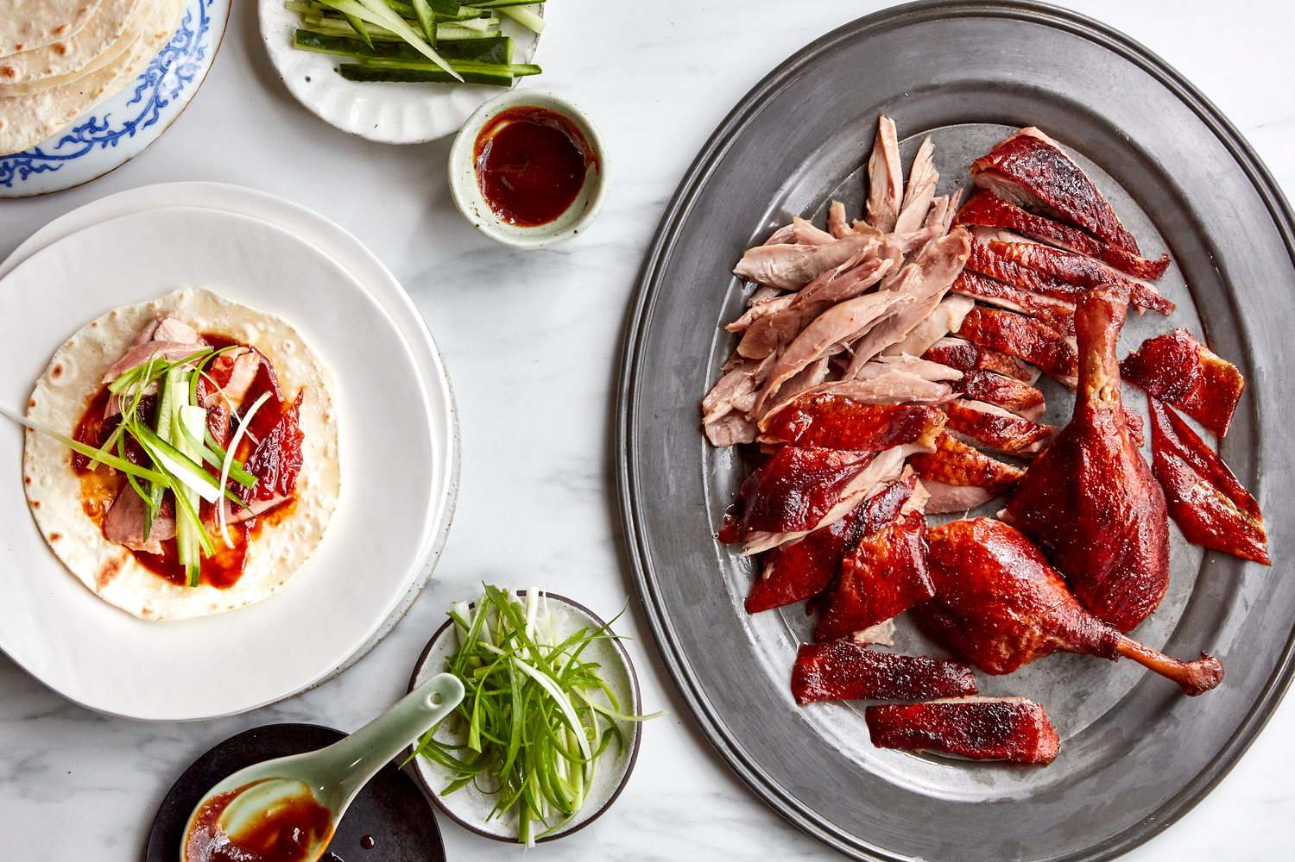
3
Consumption

Slide 12
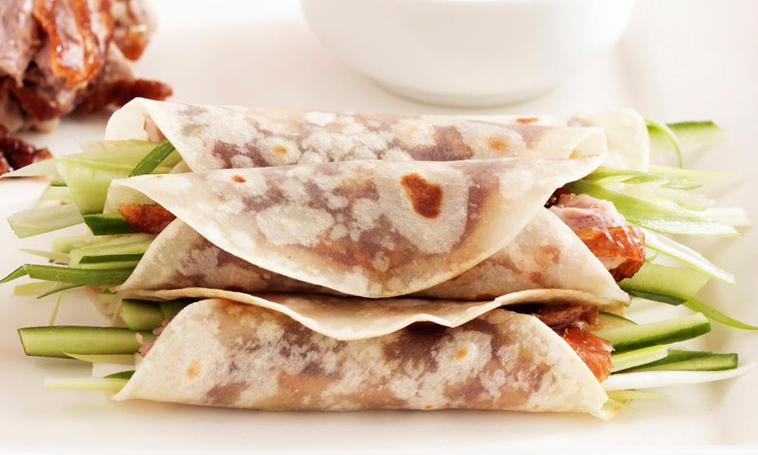
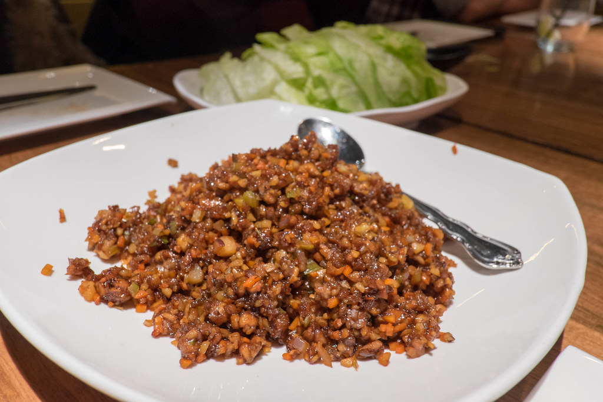
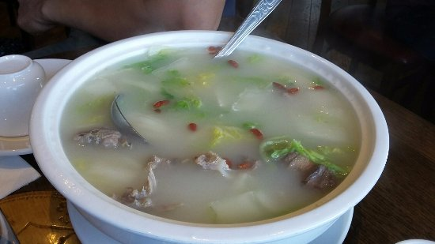
Variations of Consumption
Duck with pancake
Stir-fried Duck
Duck Bone broth
Notes:
Although the procession of courses varies slightly from restaurant to restaurant, it usually starts with a chef carving the duck tableside and serving the skin, or skin with succulent bits of meat attached, along with thin flour pancakes, hoisin sauce, scallions, and possibly cucumber batons. A stir-fry using the duck meat follows, and a milky soup made from the carcass concludes the feast. Duck bone broth

Slide 13
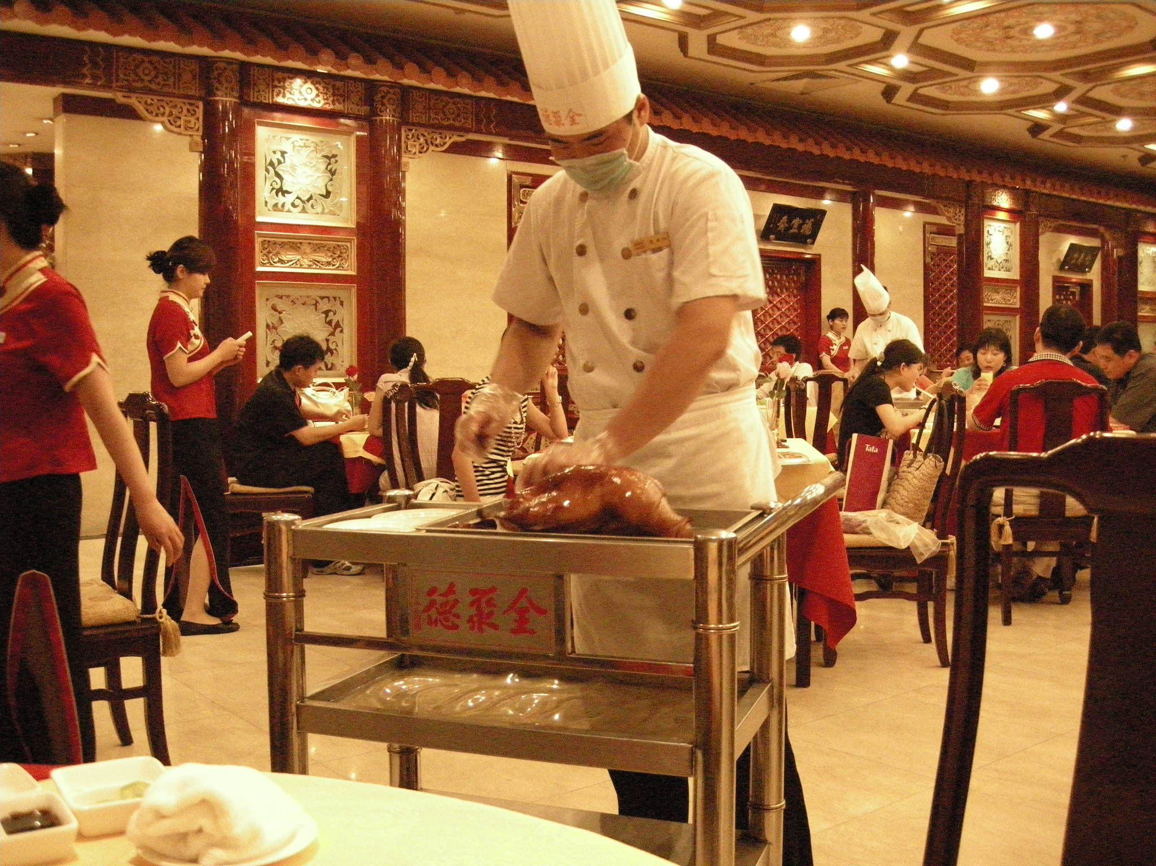
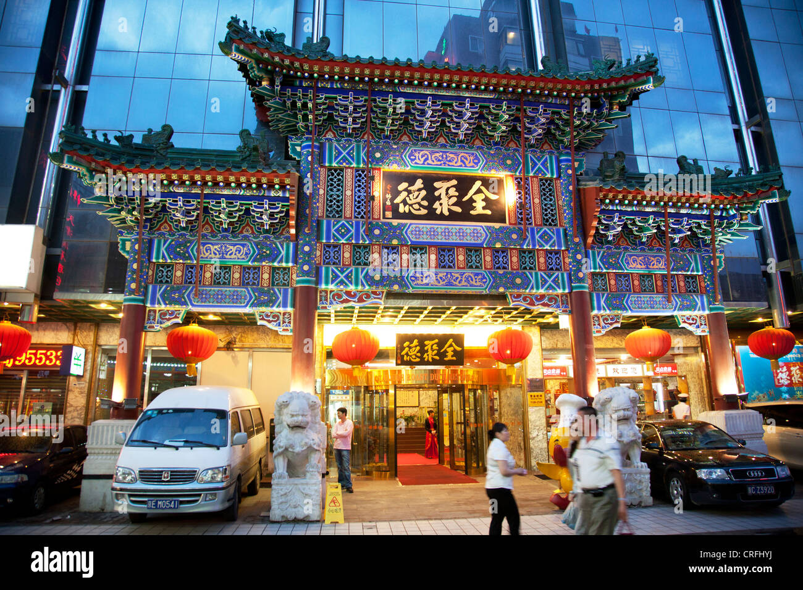
Modern Peking Duck Chain (China)
QuanJuDe
Locations: Mainland China, Taiwan, Hong, Kong, Australia, Canada, Portugal, Japan
Notes:
QuanJuDe known for its Peking roast duck and its longstanding culinary heritage since its establishment in 1864 in Beijing, China
The restaurant chain sells over 2 million roast ducks served in 400 different styles to over 5 million customers annually
Quanjude was established in 1864 during the Qing dynasty under the reign of the Tongzhi Emperor. Although Peking duck can trace its history many centuries back, Quanjude's heritage of roast duck preparation – using open ovens and non-smoky hardwood fuel such as Chinese date, peach, or pear to add a subtle fruity flavor with a golden crisp to the skin – was originally reserved for the imperial familie

Slide 14
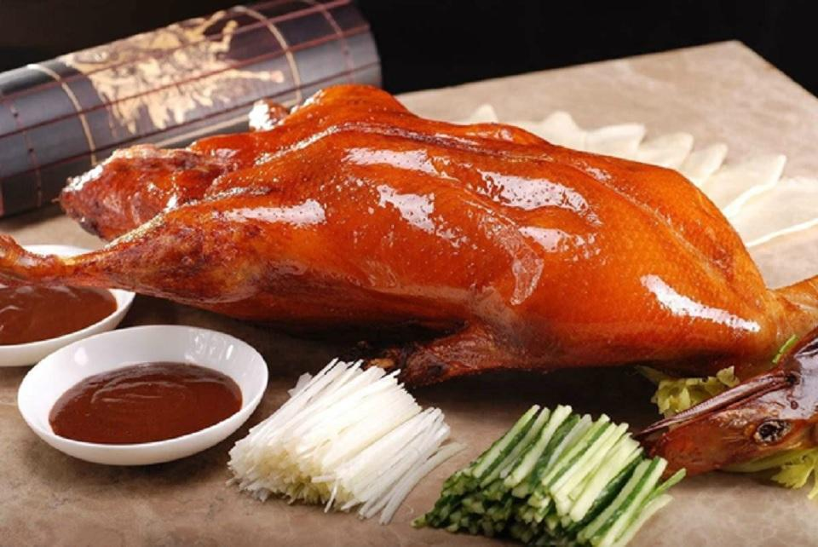
Peking Duck in USA
Peking Duck has become a mainstream dish enjoyed by all
Enjoyed in different ways and places
Fun Fact (Personal Experience):
With turkey being a sub-par bird to many, I’ve seen a shift for Peking Duck to become increasingly popular during Thanksgiving

Slide 15
Citations:
https://www.chinahighlights.com/beijing/food/beijing-duck.htm
https://theculturetrip.com/asia/china/articles/a-brief-history-of-peking-duck/
https://www.nationalgeographic.co.uk/travel/2023/01/explore-the-wilder-side-of-venice-with-the-help-of-its-fishermen
https://www.chilihousesf.com/blog/the-presidential-prestige-of-peking-duck/
https://www.thekitchn.com/a-brief-history-of-peking-duck-in-america-240837
https://en.wikipedia.org/wiki/Quanjude
https://www.britannica.com/topic/Peking-duck

Slide 16
Thank you

