Slide 1
BCD TOFU HOUSE SOONDUBU EMPIRE
Hannah Kwa

Slide 2
TABLE OF CONTENTS
01
02
03
04
SOONDUBU HISTORY
BCD HISTORY + FOUNDER
ECONOMY + POLITICS
AUTHENTICITY + LANGUAGE

Slide 3
01
SOONDUBU HISTORY

Slide 4
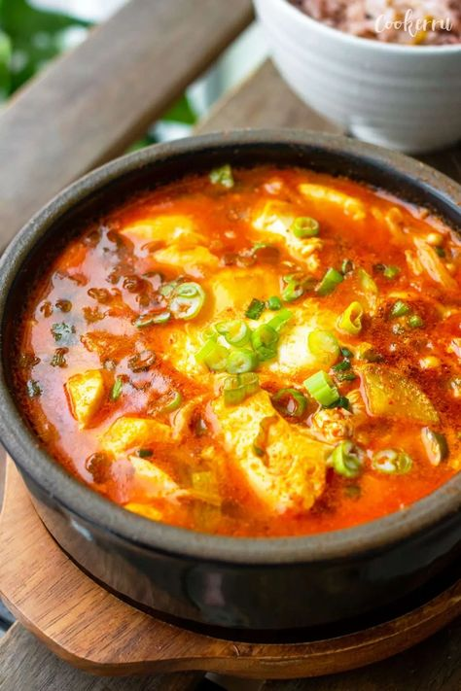
WHAT IS SOONDUBU?
Soondubu is a spicy Korean tofu stew made in a variety of ways with the addition of various vegetables, proteins, eggs, and mushrooms.
Soondubu is also called soondubu jjigae, soon tofu, and silken tofu.
Traditionally, soondubu is served in an earthenware pot with a freshly cracked egg

Slide 5
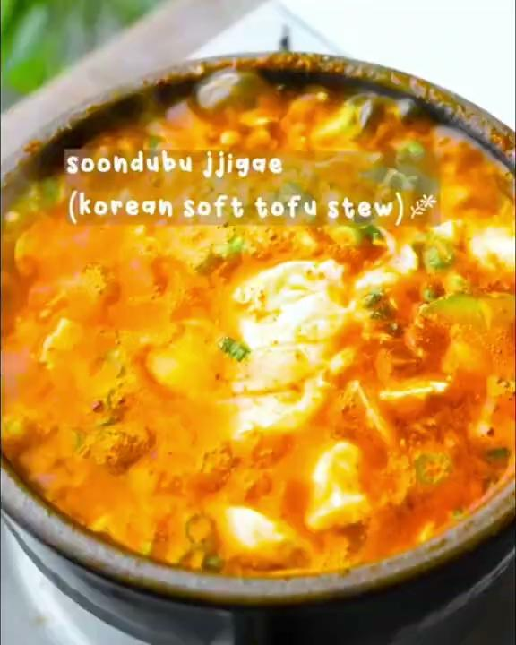
SOONDUBU HISTORY + RECIPE
Soondubu doesn’t have a clear history.
Some sources say that records from the Joseon dynasty depict early versions of soondubu.
Other sources specifically attribute the type of tofu used in soondubu to the city of Gangneung
Jjigae recipes and popularity were brought to the US post-Korean War through American servicemen
Other Korean food, including soondubu rose to prominence during the 1990s with the spread of Korean immigrant-founded restaurants

Slide 6
02
BCD HISTORY + FOUNDER

Slide 7
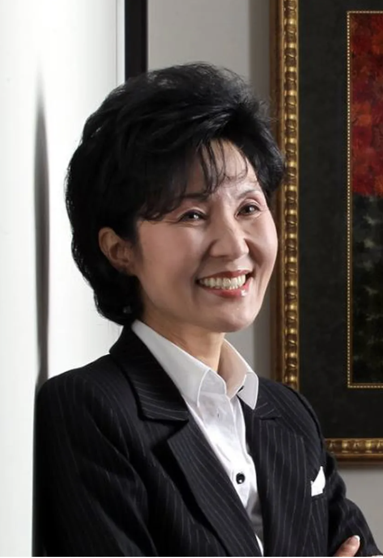
HEE SOOK LEE
Hee Sook Lee was born Seoul, Korea in 1959.
In 1989 she immigrated to the US so that her children could learn English
She began working on a secret soondubu recipe, choosing to focus on soondubu due to “its superior taste and health benefits.”
She decided to name BCD after Bukchang Dong, a district in Korea where her mother in law owned a restaurant.
In 1996, she opened the first BCD location in KoreaTown, LA.

Slide 8
START UP OF BCD
SOONDUBU
PRICE
Lee’s secret recipe for the comforting soup
Reliably keeping an accessible price
HOURS
EXPERIENCE
Open 24 hours catering to students and works
Banchan, jogi, and nurungji for every meal

Slide 9
BCD + LEE’S STORY
1996
2000
The first BCD opens in KTown LA
Lee becomes a naturalized citizen
1998
2012
BCD opens branches in Seoul, Tokyo, and Seattle
BCD has spread to have opened 13 locations nationally

Slide 10
BCD + LEE’S STORY CONT.
2013
2020
BCD lawsuit based on unfair wages
Bong Joon-ho and co. visit BCD
2015
2020
BCD soon tofu starter kits come into market
Hee Sook Lee passes. Dr. Eddie Lee takes over his mother as CEO.
Notes:
icons

Slide 11
03
ECONOMY + POLITICS

Slide 12
LAWSUIT
MARCH 20, 2013 - WORKERS FILE A CLASS-ACTION LAWSUIT AGAINST HEE SOOK LEE
MAY 5, 2015 - LAWSUIT IS SETTLED AND WORKERS ARE AWARDED 3 MILLION
Workers accused BCD of violating labor laws
Unpaid minimum wages
Unpaid overtime wages
Failure to provide meal breaks
Failure to provide break times
Failure to provide wage statements
About 600 of 1,500 total current and former employees elected to join in
Notes:
Lee + edie’s reactions ?

Slide 13
CONNECTION WITH READINGS
How does the 2013 lawsuit connect to readings on strikes and unions, specifically when regarding restaurant workers and their rights?
Is BCD part of a larger narrative of working conditions for restaurant workers in the US?
READINGS | BCD
Working conditions of workers in Chinese Restaurants in NYC, 1920-1946 | Working conditions of workers in BCD
Struggles to form unions for Chinese restaurant workers compared with the success of Delano grape farmers | United efforts of 600 out of 1,500 workers to support the lawsuit
Complicated family connections and ethnic communities | Lack of ethnic ties
Failure? | Success?

Slide 14
CULTURAL IMPACT
INTRODUCTION TO KOREAN CULTURE
POPULARITY + PRIDE FROM KOREANS
RESTAURANT MODEL
“After BCD, they would want to try other restaurants. They would want to watch Korean TV shows. It made them want to come to Korea.”
BCD’s success became the model for other Korean restaurants and those specializing in soondubu.
“When they’re talking about visiting the US and coming to LA, they say that you have to make a stop at BCD… It’s definitely LA. It’s very SoCal.”

Slide 15
POLITICAL IMPACT
INTERACTIONS WITH US POLITICIANS
KOREA-US RELATIONSHIPS
GLOBAL CHILDREN’S FOUNDATION
South Korea’s globalization of food as a soft power expansion strategy
“I consider myself a diplomat of sorts, making Korean food known to the world”
Friendship with Michelle Steel, currently Rep. of CA, then part of Orange County Board of Supervisors. Steel introduced Lee to Carly Fiorina, CEO of Hewlett-Packard (HP)
The GCF was created by Korean women whose purpose was to end child food insecurity
Lee served as president of GCF

Slide 16
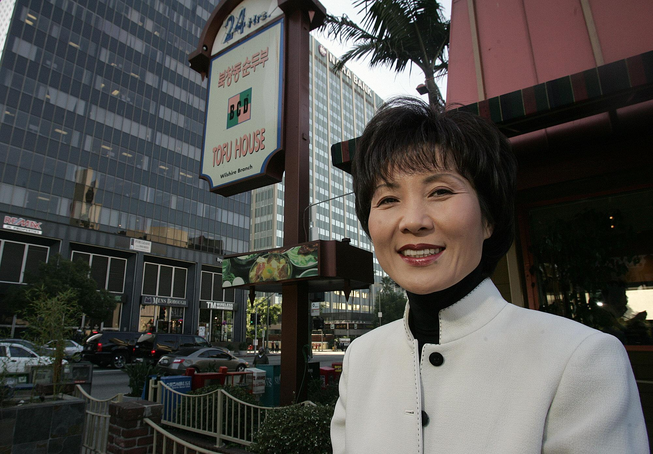
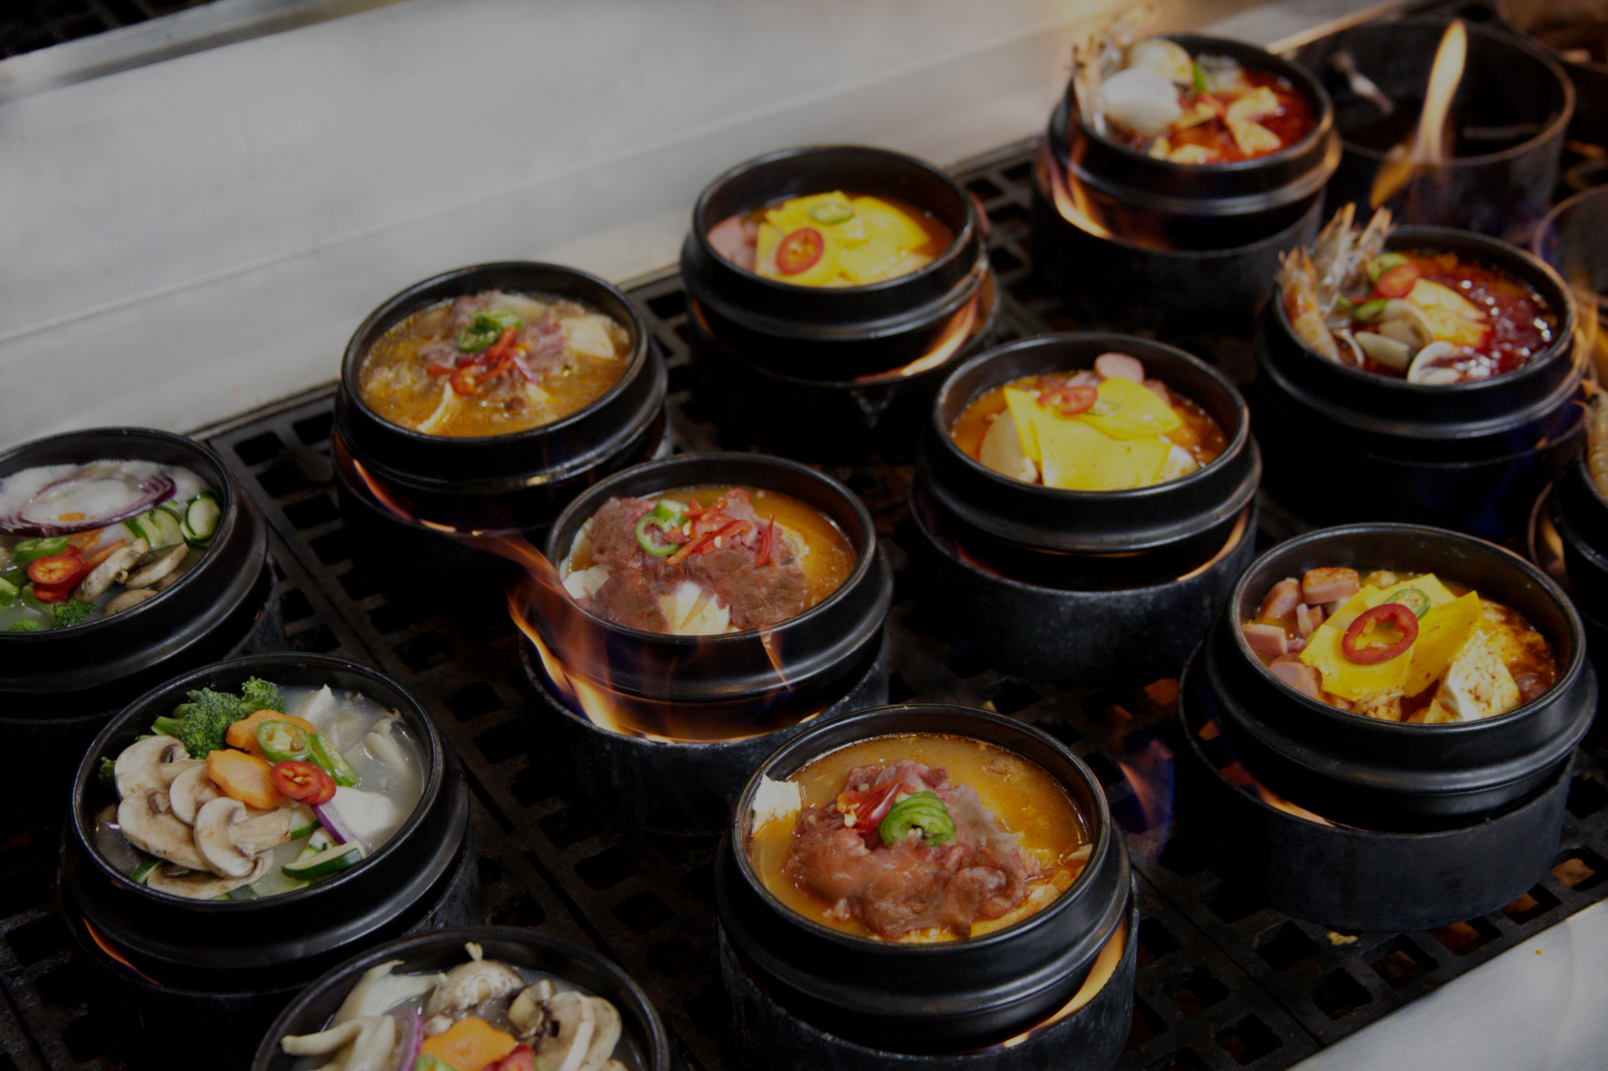
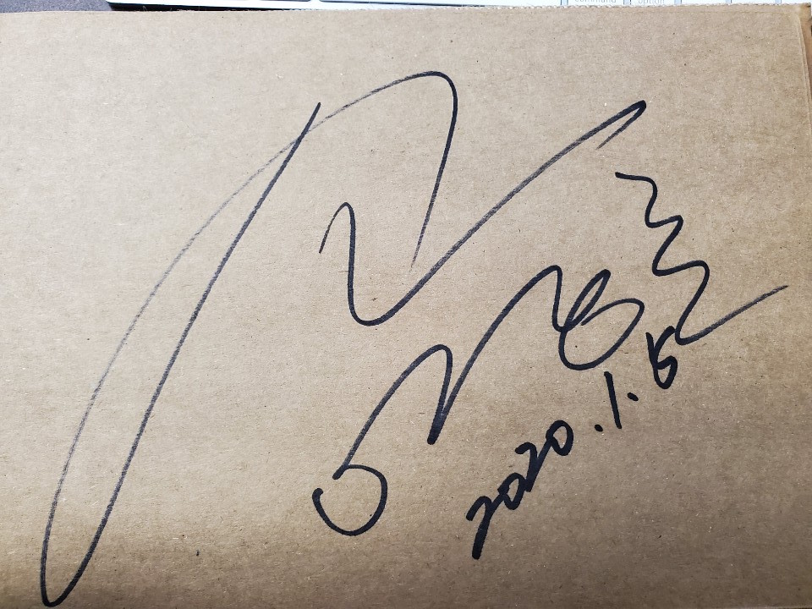
FOOD + CULTURE
Food is not separated from the establishments nor the chefs who create the food
Financial turmoil is reflected onto the value and perception of food
Marketing of food and restaurants, especially for BCD, are tied to cultural capital
Food is culture
An avenue to investigate culture for both those who seek new foods and new cultures
A grounding connection for, here, Koreans to their culture (reminder of culinary citizenship)
Notes:
Dear god fix this

Slide 17
04
AUTHENTICITY + LANGUAGE

Slide 18
THREE QUESTIONS
FOOD NAMES + LANGUAGE
ASIAN-AMERICAN EXPERIENCE
ASIAN-AMERICAN FOOD
How do the names of food factor into their positionality in food?
How does BCD and Lee’s history reflect Asian-American experiences?
Is soondubu a Korean, American, or Asian-American food?

Slide 19
NAMES OF SOONDUBU
SOONDUBU JJIGAE | 42%
SOON TOFU | 1%
Interestingly, BCD was the only one to use this name
Soondubu name with the addition of the Korean romanization of stew
SOONDUBU | 25%
TOFU STEW | 25%
Direct Korean romanization, also the name I grew up knowing
A complete translation of Soondubu Jjigae
Notes:
Follow the link in the graph to modify its data and then paste the new one here. For more info, click here
https://docs.google.com/spreadsheets/d/1WkWzhWNROeHMfChaYe1zCnYBy34mObWY0uca_q_2MLo/edit#gid=331389223

Slide 20
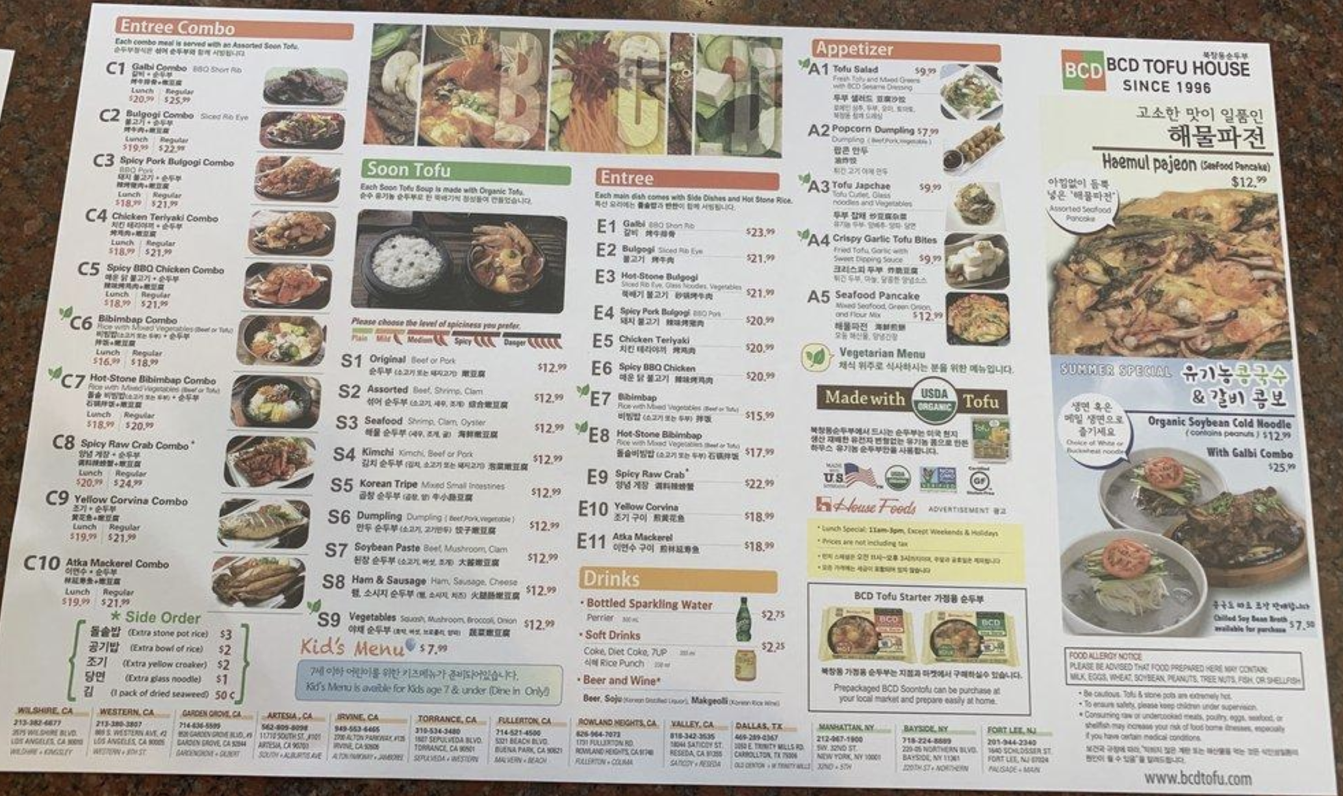
BCD’S MENU
The names of each dish are in English, Korean names are underneath
Being able to choose the spice level of each soondubu dish
Style of the menu follows closer to traditional Asian restaurant menus
Pride in use of the USDA Organic Tofu

Slide 21
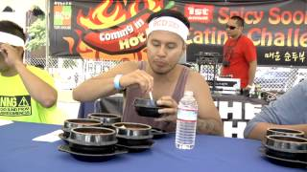
WHO IS THE AUDIENCE?
Whose approval matters the most? Praise from Koreans, non-Koreans experiencing Korean culture, white Americans?
On one hand, Lee makes efforts to connect with her Korean customers
Praise from Koreans
Greeting returning customers
On the other hand, Lee makes efforts to appeal to non-Korean Americans
Creating videos making BCD’s food more accessible
Making menu changes to be accessible to eaters
Gaining recognition from specifically white Americans.
Notes:
VID OF EATERS → HOW IS BCD PRESENTED

Slide 22
LEE: AN AMERICAN SUCCESS STORY?
ARGUMENTS FOR YES
COMPLICATIONS
Immigrant who gained a degree, became a naturalized citizen, contributed to both American economy and American-Korean cultural-political relationships
Created her own restaurant using her own recipe, a true self-made business woman
Giving back to her community by creating connections with customers, participating in foundations to serve children, connecting with politicians of her area
Her husband having success in business, specifically restaurant businesses - leading to the knowledge that she had financial support and a safety net
Contributing to the model minority myth: “To those asking for the secret to her success, Lee smiles sheepishly and says there really isn’t much to it. ‘To succeed in anything, you just have to be fanatically devoted to it.’”

Slide 23
WHAT IS
ASIAN-AMERICAN FOOD
There are 4 ways to understand Asian-American food
Any Asian food made in America
Any food made my Asians in America and/or Asian-Americans
Americanized versions of traditional Asian food
A new genre of food separate from Asia or America

Slide 24
WHAT IS
AUTHENTICITY
Authenticity is often tied to food, specifically ethnic food such as Asian-American food, as a method to validate, compliment, and enforce definitions and parameters of food
Who is the authenticator of food? What kind of power do they hold over food?
Authenticity is often times equated to tradition. For Asian-Americans, who do you remain authentic or traditional too? Consider that Asia and Asian food is constantly in flux, just at much as Asian-America is.

Slide 25
ARGUMENTS FOR BCD BEING AN ASIAN-AMERICAN FOOD
STARTUP + SUCCESS IN AMERICA
SUCCESS IN US VS KOREA
01
03
POPULARITY WITH AMERICANS
LEE’S PERSONAL RECIPE SUCCESS
02
04
BCD is an American corporation, started in the US, expanded throughout the US and the American market
“BCD was actually a Korean American brand that had only opened locations in Asia after finding success in the US.”
“They say that you have to make a stop at BCD… It’s definitely LA. It’s very SoCal.”
Lee’s recipe as a mix of what she knew from Korea and the popular flavors approved by American eaters

Slide 26
ARGUMENTS AGAINST BCD BEING AN ASIAN-AMERICAN FOOD
SOONDUBU FROM KOREA
MENU FOCUS ON KOREAN FOOD
01
03
MARKETING KOREAN CULTURE
CURRENT LABELS AS KOREAN FOOD
02
04
The original dish and its ingredients, regardless of popularity, originated in Korea
No fusion elements, no traditional American foods, very little explanation of dishes
The menu, website, and key components are all presented as Korean elements
Note the common occurrence to label ethnic food based of the “authentic origins”

Slide 27
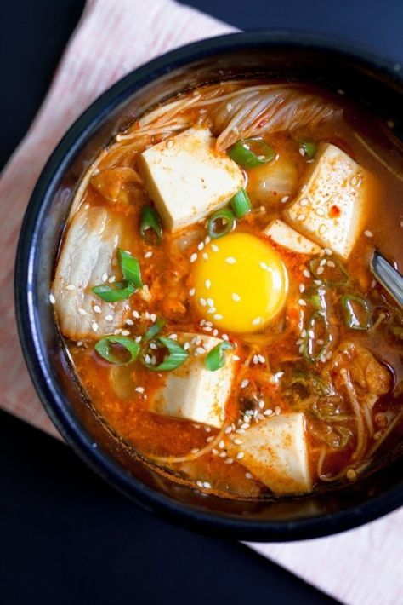
WHAT DO YOU THINK?
IS BCD SOONDUBU AN ASIAN-AMERICAN FOOD?

Slide 28
REFERENCES + SOURCES
https://www.bcdtofuhouse.com/about
https://www.nytimes.com/2020/08/25/business/hee-sook-lee-dead.html
https://laist.com/news/bcd-tofu-house-hee-sook-lee-obituary-cultural-legacy-korean-food
https://www.latimes.com/food/story/2020-08-05/hee-sook-lee-obit-bcd-tofu-house-soondubuee-sook-lee-dead
https://la.eater.com/2020/8/4/21354254/hee-sook-lee-bcd-tofu-korean-restaurant-founder-died
https://eportfolios.macaulay.cuny.edu/storefrontsurvivors/2017/06/01/bcd-tofu-house-a-success-story-of-a-korean-underdog/
https://en.wikipedia.org/wiki/Hee_Sook_Lee
https://drivemehungry.com/soondubu-jjigae-korean-tofu-soup/
https://mlee214.wordpress.com/2014/05/09/discovering-tofu-the-origins-of-soondubu-jjigae/
https://www.seouleats.com/2014/11/food-story-korean-soondubu.html
https://globalchildren.org/en/homepage-charity-english
http://www.bcdtofuhouselawsuit.com/the-law.html
https://www.latimes.com/archives/la-xpm-2008-jan-24-fi-tofu24-story.html
https://seoulofla.com/2013/05/10/from-los-angeles-to-seoul-bcd-tofu-house/
http://www.koreatimesus.com/bcd-begins-to-pay-out-3-mil-in-settlement-to-600-employees/
https://www.hse.ru/en/edu/vkr/126112290

Slide 29
THANK
YOU!

Slide 30
BCD TOFU HOUSE SUMMARY
→ What is soondubu? A spicy Korean tofu stew made in a variety of ways with the addition of various vegetables, proteins, eggs, and mushrooms.
→ Who founded BCD Tofu House? Hee Sook Lee (born in Korea, immigrated to the US with her sons to learn English and gain an education, planned to open a soondubu restaurant)
→ Key dates: First BCD location (1996), 13 locations in America (2012), lawsuit around workers rights (2013), Lee passes and her son becomes the CEO (2020)
→ How does food intersect with economy, politics, and culture?
Economy: workers lawsuit settled (2015), BCD as a restaurant model
Politics: Korea-US relationships (within Korean soft power strategy using globalization of Korean food), Lee’s work w the Global Children’s Foundation + friendship w politicians (ex. Michelle Steel)
Culture: introduction to Korean food/culture, pride from Koreans
→ How can BCD’s soondubu be analyzed as an Asian American food?
Translations + names of soondubu: soondubu, soondubu jjigae, soft tofu stew, soon tofu
Menu + marketing: catering to both Koreans and non-Koreans
Lee’s success: does she exhibit the model minority myth?
Various ways to define Asian American food
Authenticity debate: Is authenticity necessary/key? Is BCD authentic? Does it matter?

Slide 31
PROJECT TAKEAWAYS
→ Food is a mix of nostalgia, history, economics, and culture made accessible through its universality
→ BCD’s history involves large cultural impact centered on Lee’s involvement in geopolitics and vision for her food in America
→ Soondubu, specifically BCD’s version, raises important questions about how we may define and discuss Asian American, or perhaps Korean American, food

