Slide 1
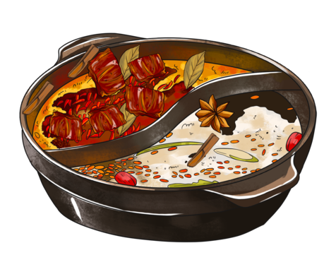
HOTPOT
Brandon Cao

Slide 2
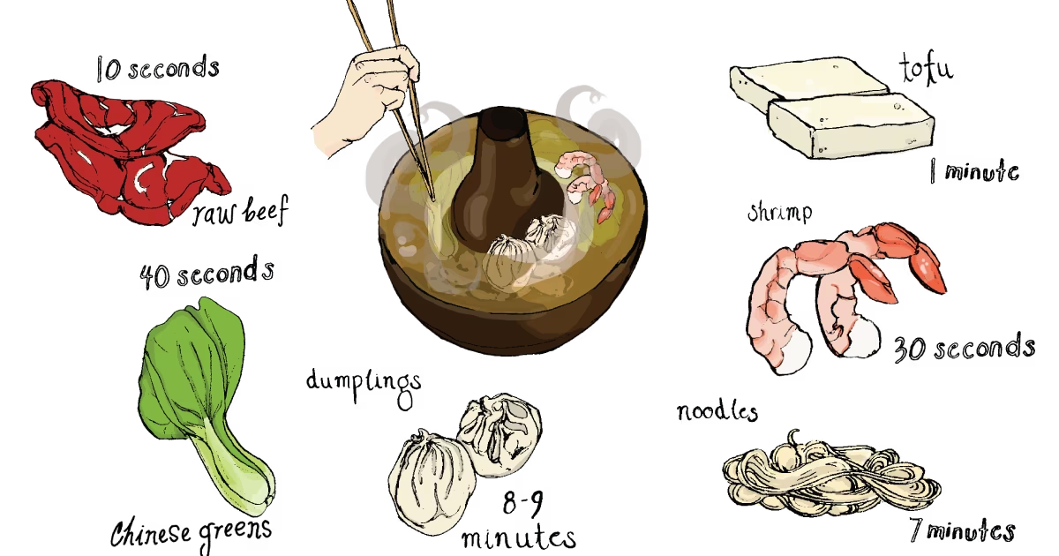
History of Hotpot
"Hot pot" in Chinese is huǒguō (火锅), literally: 'fire pot'.
History of more than 1000 years, and China is regarded as the home of hotpot, although there are lots of arguments about the origin of hotpot
Communal aspect came from Mongol warriors who camped outside and had dinner together circled around a pot on the fire

Slide 3
History

Slide 4
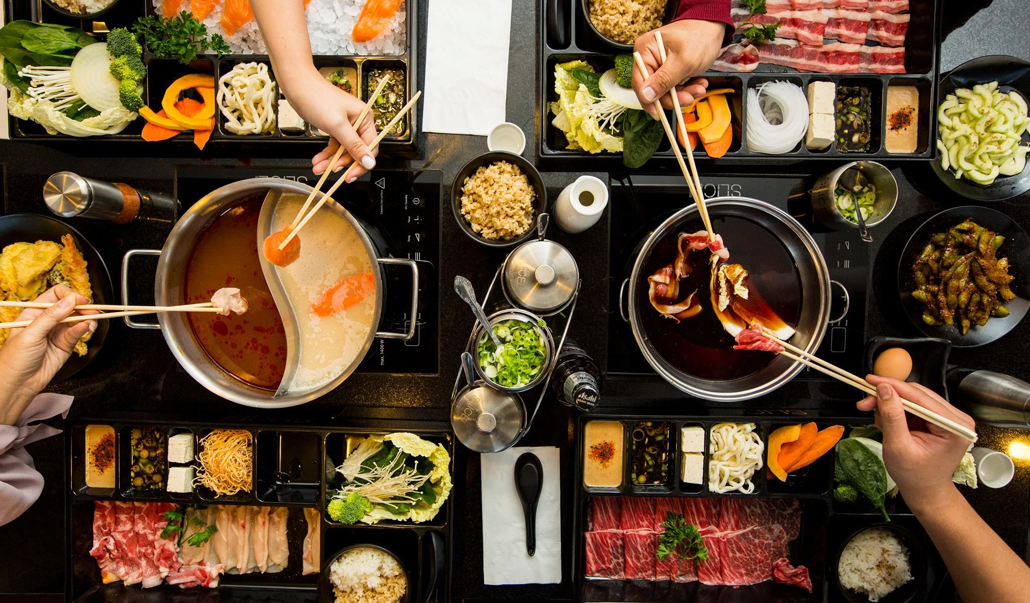
What is Hotpot?
The general idea is that while the hot pot brew is kept boiling, fresh ingredients are placed into the pot and are cooked at the table. This basic principle has not changed over time.
Notes:
A big pot filled with simmering broth is placed at the middle of the table, accompanied by plates of various meats, vegetables, noodles, condiments, and dipping sauces. The ingredients are to be placed in the broth, cooked, and then taken out and dipped into the chosen sauce before eating.

Slide 5
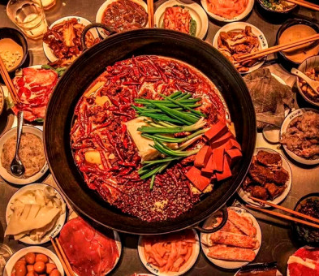
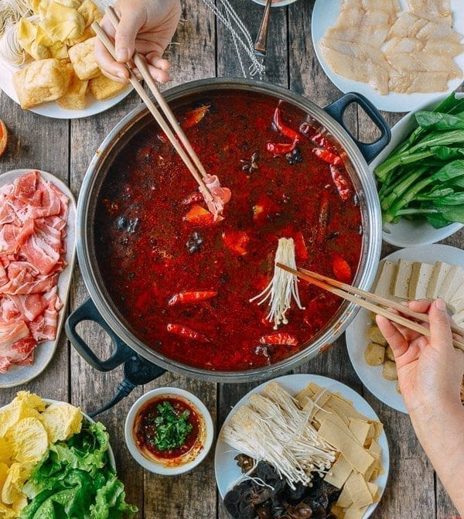
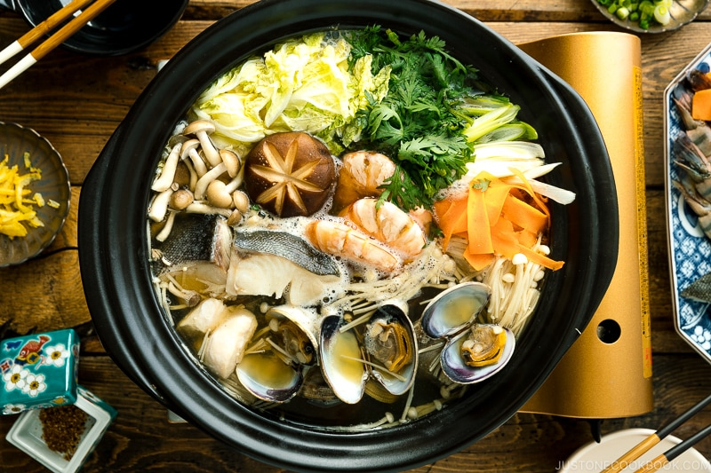
Three Popular Types of Hotpot
Chongqing Hotpot
Sichuan Hotpot
Japanese Hotpot
Notes:
Chongqing hot pot will be filled with a large amount of beef tallow that has been pre-fried with chili peppers, Sichuan hot pot generally does not use spicy beaf tallow, but water and rapeseed oil. Because rapeseed oil does not have the special aroma of tallow, some extra spices and chili peppers will be added.
In terms of ingredients, there are also some differences between the two. Chongqing hot pot is also known as “tripe hot pot”. Animal offal such as tripe, cow throat, duck blood, cow blood and so on are the main ingredients, while Sichuan hot pot has a wide range of ingredients. Beef, mutton, pork and all kinds of vegetables can be added.
Japanese hotpot has a lot of different variations, but a really popular Western one is Shabu Shabu. The difference is that uses a shallow iron pot, compared to a Chinese hotpot. Shabu Shabu is supposedly named because of the swooshing sound that is made when you cook food.

Slide 6
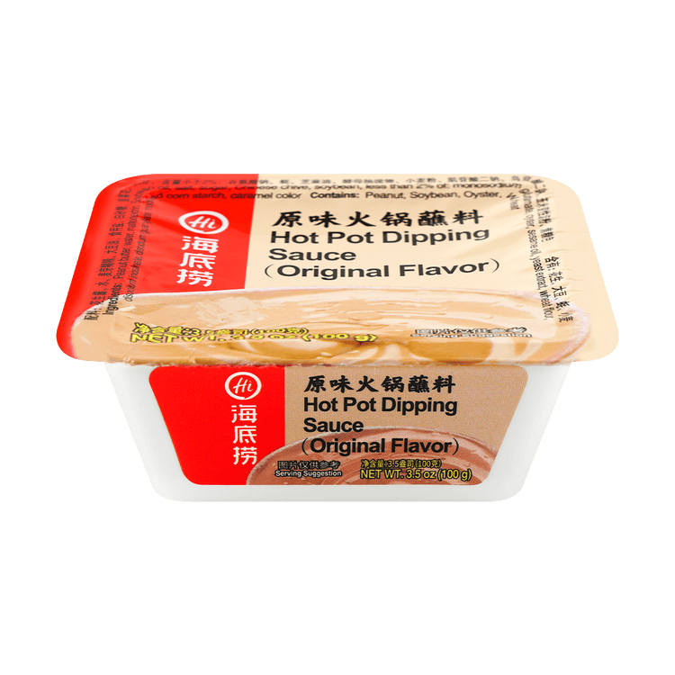
Hotpot in America
In recent years, hotpot has grown very popular especially in major cities.
The most famous and popular hotpot chain, Haidilao, is well known for its esteemed customer service and high quality ingredients.
More of a experience than a restaurant
Raises questions about the economics
Famous-prepackaged
Haidilao Sauce (really good)
→
Notes:
Some hot pot restaurants have make-your-own condiment sauce bars while others do not. A typical combination is sesame oil with a little bit of soy sauce or a diluted sesame paste. You can also add chili oil, scallions, sesame paste, cilantro, green onions, or whatever suits you. There are no rules when it comes to condiments.
Free manicures, free upgrades to private rooms, aprons, even offers a giant teddy bear as company

Slide 7
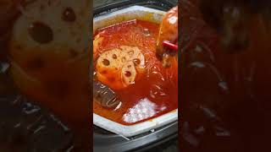
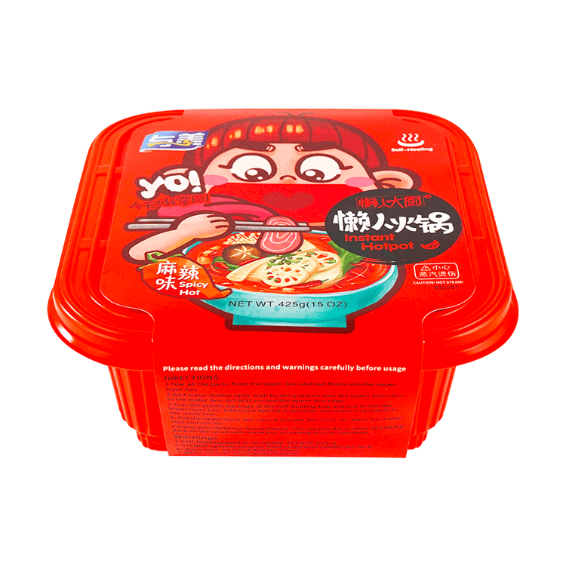
Economic Factors of Hotpot
Huge expansion in Western culture
How do hotpot restaurants make money?
Commodification of experience
Hotpot industry exceeds 150 billion
Self heating instant hotpot →
Notes:
Hotpot and other “self-cooking” food experiences like KBBQ and JBBQ are extremely popular in Asia, you know, where they originated from and have been a cultural home and restaurant staple for a long time.

Slide 8
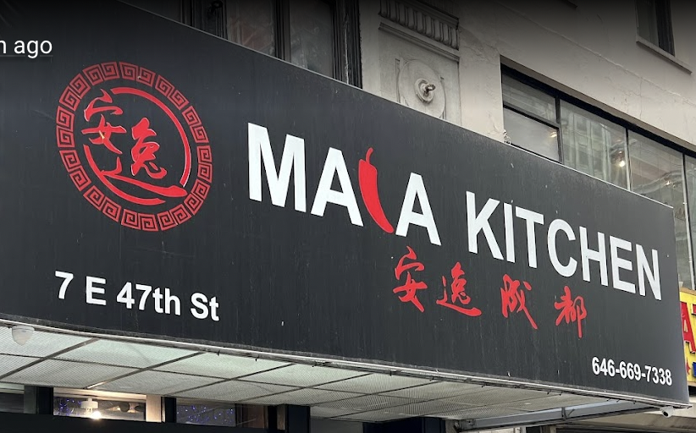
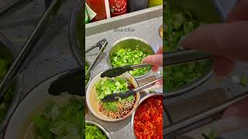
Controversies and fun facts
“Mala Kitchen” faced backlash after people found out owner was a white woman who misrepresented herself as a Sichuan native in advertisements.
Notes:
This controversy sparked a debate about her actions, one side stating that by misinforming customers of serving “authentic” Sichuan-style hotpot, you are culturally appropriating Sichuan culture. Supporters of Mala Kitchen argue that white ownership reflects the innovation of Asian-American cuisines and that the restaurant should be judged based on quality and authenticity rather than the race of the owner.
https://www.latimes.com/food/story/2022-06-02/gas-stove-ban-chinese-korean-bbq-electric-new-buildings-restaurants-future

Slide 9
References:
https://www.latimes.com/food/story/2022-06-02/gas-stove-ban-chinese-korean-bbq-electric-new-buildings-restaurants-future
https://daoinsights.com/works/haidilaos-unique-customer-service-makes-hotpot-world-famous/
https://www.andrew.cmu.edu/user/sysun/

