Slide 1
SUSHI &
NOSTALGIA
Sushi’s Role in the U.S.
Banri Saito

Slide 2
2 Questions in Addressing this Topic
What does one do when they crave an unattainable nostalgia?
How do other cultures or people of another culture benefit from this nostalgia?

Slide 3
History of Sushi in the U.S.
1966- Opening of Kawafuku, Japanese restaurant that offered traditional nigiri zushi in Little Tokyo (Los Angeles, CA)
Tokyo Kaikan- one of the first to create the California (although who is to be credited is still debated)
Notes:
Sushi was first introduced to the U.S. by Japanese immigrants.
Kawafuku first opened in Little Tokyo in 1923 by Takichi and Hana Kato. However, while they did serve other Japanese foods such as sukiyaki, sushi was not offered then. After WWII, Kawafuku was taken over by Tokijiro Nakajima which offered a menu of nigiri that was primarily based around local seafood such as sea urchin, abalone, mackerel, and tuna. However, the restaurant also used seafood that was shipped from Japan’s Tsujiki Market. This form of nigiri zushi was no doubt very close if not the exact same kind of sushi you would expect to find at a nigirizushi restaurant in Japan. Around the time that Kawafuku opened, Tokyo Kaikan also opened. While Kawafuku catered mostly to Japanese immigrants, Tokyo Kaikan additionally had some American patrons. Tokyo Kaikan is often credited to be one of the first restaurants to come up with the idea of a California roll. The Michelin website writes that “chef Ichiro Mashita invented the roll when he swapped out king crab for fatty tuna when the fish was out of season, and opted to turn the roll inside out to assuage Americans’ aversion to seeing seaweed.” While many asian ingredients are seen as trendy today, it is important to note that sushi that developed in the U.S. also tend to cater towards Americans and their conceptions of what is “civilized food.”

Slide 4
“I once ate so much at the Tokyo Kaikan that I couldn't stand upright. I stumbled out of the restaurant doubled over struggling to see where I was going. Sure, I was just a kid at the time, but the food there was so good that it was easy to ignore the recurring warning signs of being full and just keep on eating.
If you are a purist, you may not like American Sushi, preferring to stay with Nigiri Sushi or Maki Sushi. But, if you like Rainbow Rolls or other American Sushi Rolls, then we owe Chef Mashita a debt of gratitude for his originality and creativity in venturing outside the boundaries of traditional Japanese sushidom to create a sushi revolution.”
—Clyde R. from a Yelp review on Tokyo Kaikan
Notes:
Clyde from this Yelp review talks about his childhood and one can understand that there is a hint of nostalgia of this restaurant, but also pride towards the fact that one of his favorite restaurants led a major change in sushi that is subsequently embraced by the U.S. consumers.

Slide 5
“I once ate so much at the Tokyo Kaikan that I couldn't stand upright. I stumbled out of the restaurant doubled over struggling to see where I was going. Sure, I was just a kid at the time, but the food there was so good that it was easy to ignore the recurring warning signs of being full and just keep on eating.
If you are a purist, you may not like American Sushi, preferring to stay with Nigiri Sushi or Maki Sushi. But, if you like Rainbow Rolls or other American Sushi Rolls, then we owe Chef Mashita a debt of gratitude for his originality and creativity in venturing outside the boundaries of traditional Japanese sushidom to create a sushi revolution.”
—Clyde R. from a Yelp review on Tokyo Kaikan
Notes:
However, with authenticity in mind, the phrase “if you are a purist” stood out to me. Perhaps in this context, being a purist means to be sticking to traditional values. Even Eric Rath’s “Oishii: History of Sushi” also writes that “sushi experimentation might seem…inauthentic to some self-described sushi purists,” (7). If you value traditional Japanese cuisine, does that mean that you would not find these “Americanized” foods to be appealing? Moreover, maybe a person would enjoy both, but prefer one over the other. In such cases what would factor into these preferences? Here, I decided to conduct an interview with my colleagues to get a better grasp at understanding these ideas.

Slide 6
research
With colleagues!

Slide 7
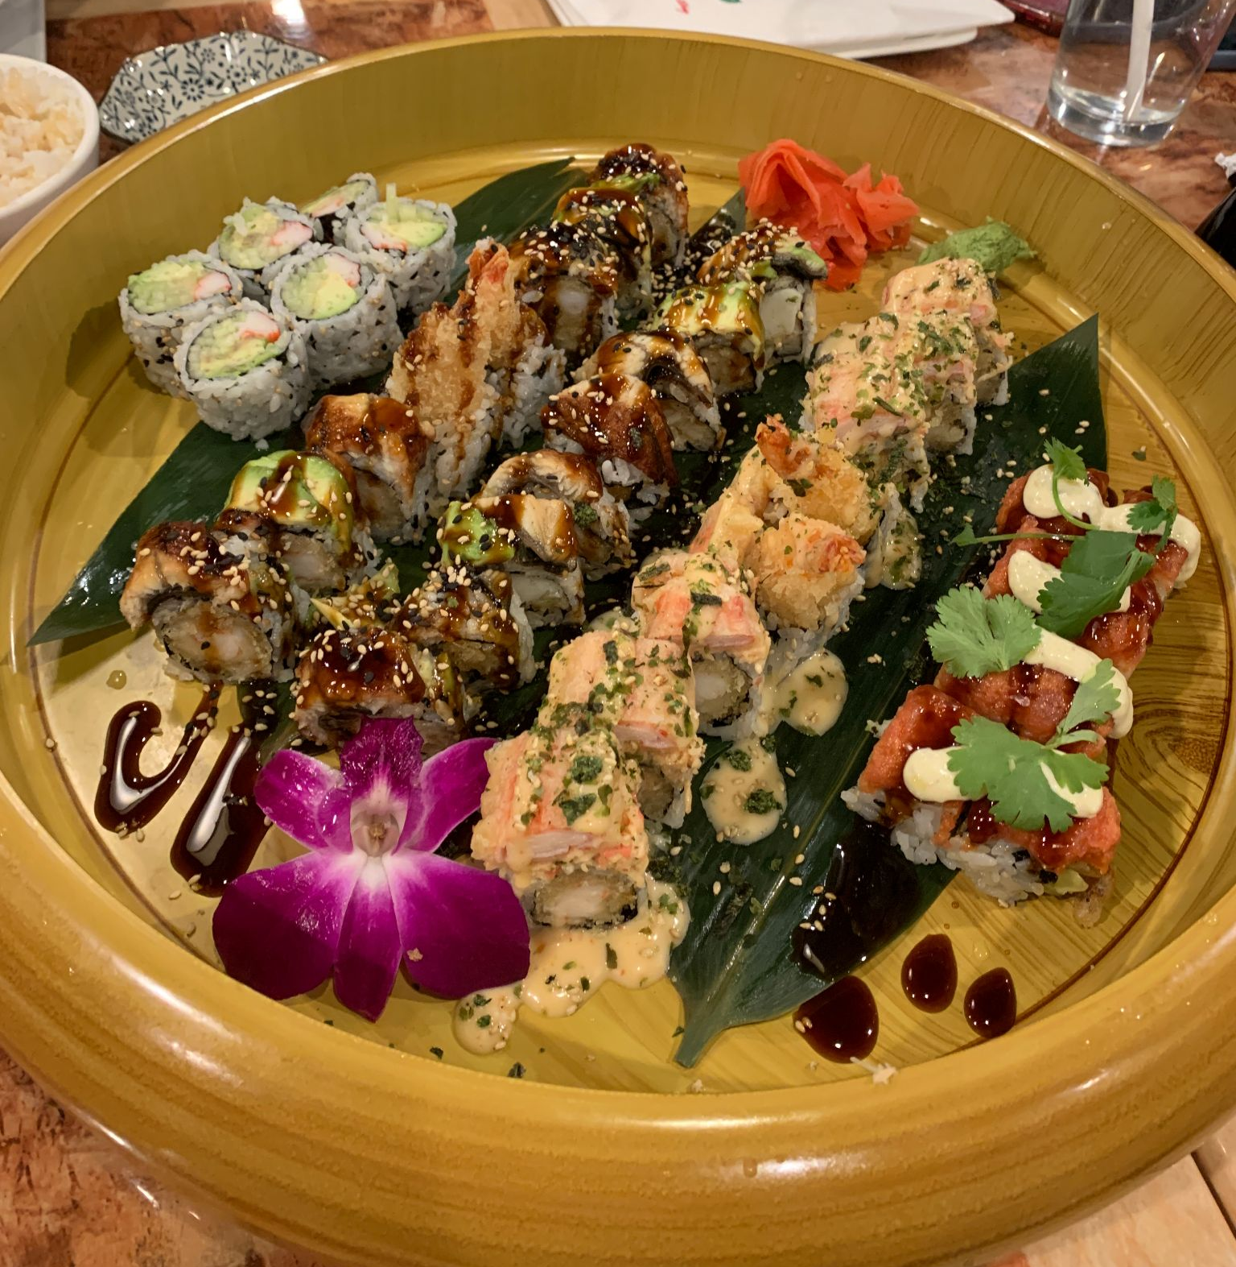
Hachi (sushi in Middletown)
Japanese restaurant in Middletown
Serves many kinds of sushi

Slide 8
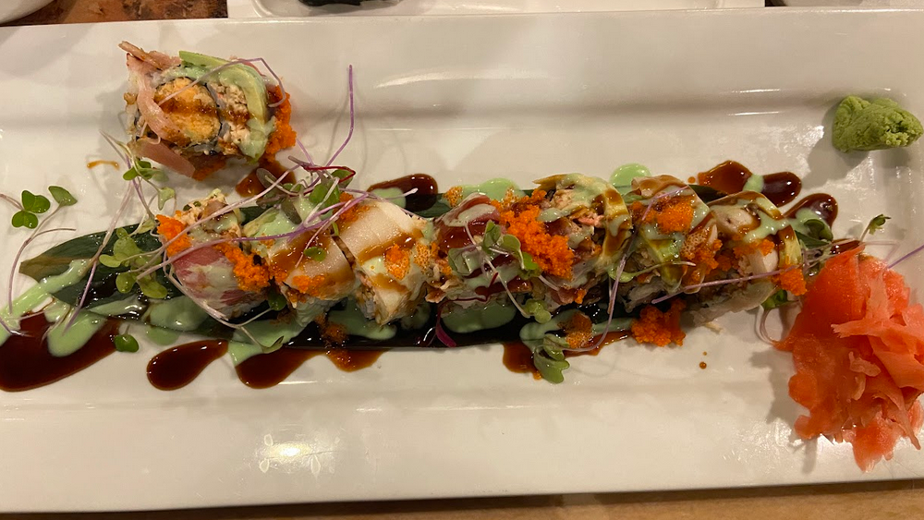
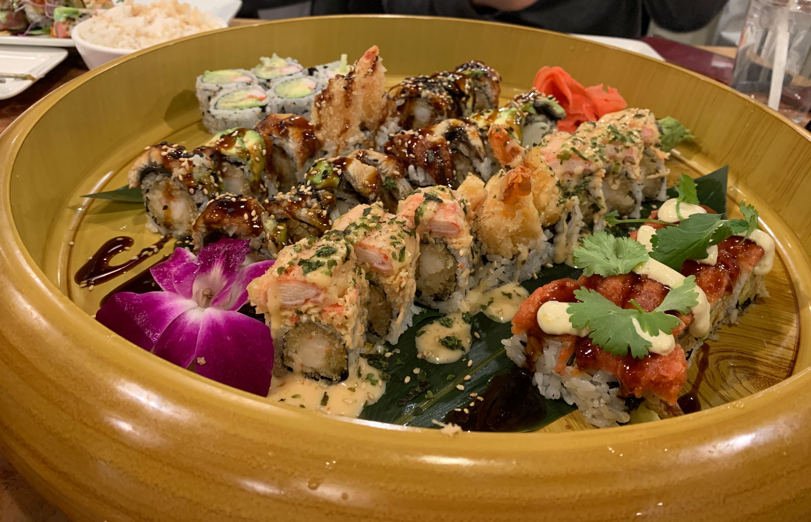

Slide 9
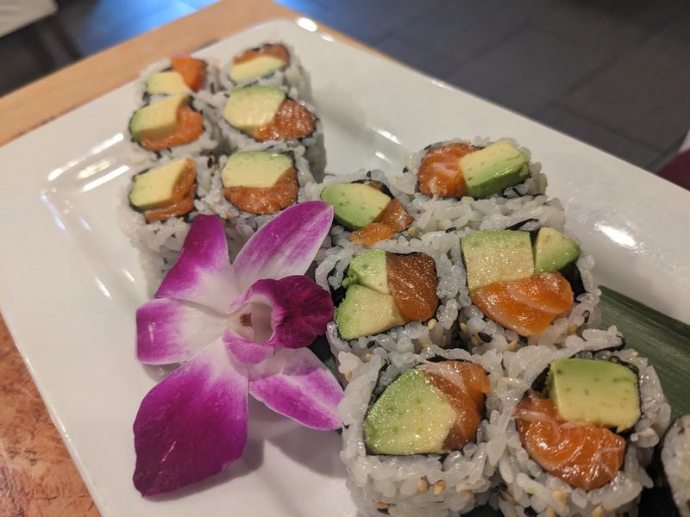
“Hachi was not as fresh. I had the salmon avocado roll. The fish seemed so squished. I like how it was decorated. It was cute but I’m not sure if I’ve ever seen anything like that.”
“[In terms of shape, American sushi] tends to be more square instead of circular and there is an artificial taste to the wasabi.”
Chika Simon
“The rolls at Hachi were more creative. They also had a lot more add-ons than the Japanese rolls I’ve had. [It was] very visually appealing and flashy. It tasted good…but there was a different feel to it.”
Diana Tran
Notes:
Compared to Japanese sushi.

Slide 10
Authenticity
“In order to protect sushi’s authenticity as being Japanese, Japanese government and organizations took actions to regulate the sushi market as well as the image of Japanese food since early 2000s,” (Yang, 77).
Ironic, because sushi originated in China, but they are not giving credit to where it is due.
Notes:
Yang mentions that “despite the view of many people that Japan protects its traditions well, Japanese culture is unique or even exclusive, in fact in many respects, Japanese culture is open and flexible,” (Yang, 75). Yang further exemplifies this through the Japanese language in which borrowed words are often integrated into the structures of the language. This “flexibility” (as coined by Yang) is also illustrated in sushi with the versatility of ingredients that can be used.

Slide 11
“Sushi may be associated with Japan…but sushi was never solely a Japanese dish. Today, anyone can make their own sushi roll and put anything they want in it, and even deep-fry it, should they choose to.
[Sushi] may be a representative Japanese food, but it was not found throughout all of Japan historically.
Sushi is a very simple food, but it is often exoticized, which is another reason why we need a careful exposition of where sushi came from,” (Rath, 24).

Slide 12
When craves unattainable nostalgia…
“I cook Japanese food once or twice a week. It is hard to get Japanese food, vegetables, and its ingredients. I go to Japanese or Asian grocery stores by driving 1-1.5 hours away.”
Kumiko Nakamura (has lived in the U.S. for 25 years so far)
「似たような食材を探して使う。前から住んでいる日本人に相談してみる。」
“I try to make Japanese food with similar ingredients. When I have troubles making it, I ask other Japanese people who has lived in the U.S. longer than me for advice.”
Tomoko Saito (has lived in the U.S. for 21 years)

Slide 13
“When I came to Kentucky for school and lived in the dormitory, I brought my dry ingredients and seasoning with me so that I could make my dishes. However, my asian cooking can be flexible. If I can’t make curry, there is always sweet & sour or ginger & green onion flavors. I made Asian dishes daily and my friends loved my asian barbecue ribs.”
Clara Chan (came to the U.S. since she was a teenager and has lived in the U.S. for 39 years so far)

Slide 14
References
Rath, Eric. Oishii: The History of Sushi. London : Reaktion Books, 2021.
Yang, Wen. “THE "AUTHENTICITY" OF SUSHI: TRANSFORMING AND MODERNIZING A JAPANESE FOOD.” Master of Arts, University of Arizona, 2013.
Avey, Tori. “Discover the History of Sushi.” Public Broadcasting Service, September 5, 2012. https://www.pbs.org/food/the-history-kitchen/history-of-sushi/.
Michelin. “The History of Sushi in America.” Last modified November 15, 2019. https://guide.michelin.com/us/en/article/features/sushi-history-america-los-angeles

Slide 15
Please keep this slide for attribution.

