Slide 1
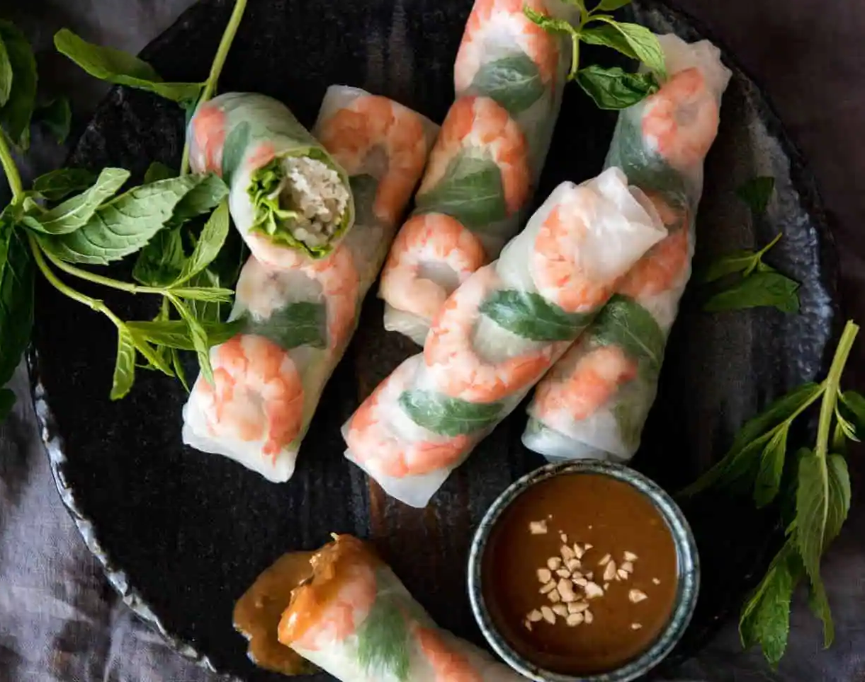
Vietnamese Rice Paper Rolls
By: Amy Zang

Slide 2
TABLE OF CONTENTS
01
02
03
04
05
06
Origin
Authenticity
Economic
Geographic position
Political Identity
Current study

Slide 3
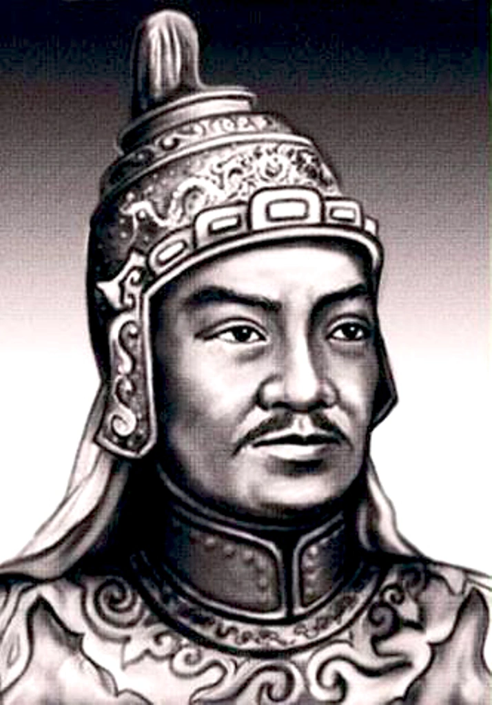
Origin
There is a story that there was a king that wanted to make Vietnam powerful through war, so he wanted his soldiers to always be on the move. The soldiers didn’t have much time to settle down to cook and eat, so they made these summer rolls that could be eaten while traveling.
The origin of Vietnamese summer rolls depends on the angle that it is viewed through. Some say that spring rolls originated from China and summer rolls were an adaptation to suit Vietnamese tastes. Others argue that rice paper was created in Vietnam, so summer rolls originated from Vietnam.
Nguyễn Huệ Quang Trung

Slide 4
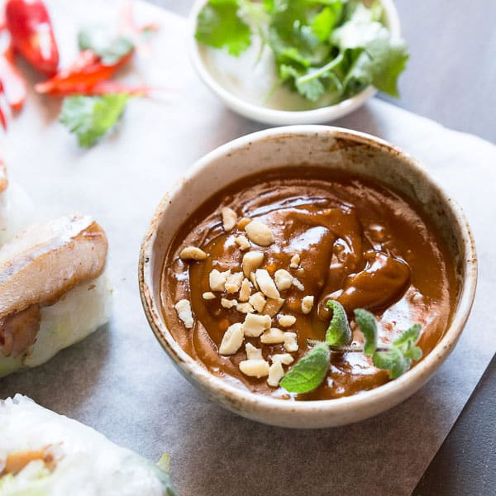
Authenticity
North Vietnam
Central Vietnam
South Vietnam
Thin and delicate rice paper
Dipping sauce: combination of fish sauce, lime juice, garlic, chilli, water and sugar
- Dipping sauce: peanut sauce
Thick and chewy rice paper because of addition of tapioca flour
Different options of dipping sauce: Vietnamese fermented bean paste and soy sauce; fermented anchovy, crushed pineapple, sugar, lemon juice, bird’s eye chilli, lemongrass and garlic; fish sauce, lime, sugar, garlic and chilli
In General:
Rice paper wrapped pork and shrimp, rice vermicelli, raw vegetables and fresh herbs

Slide 5
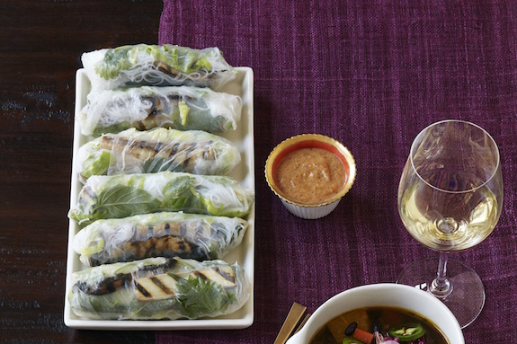
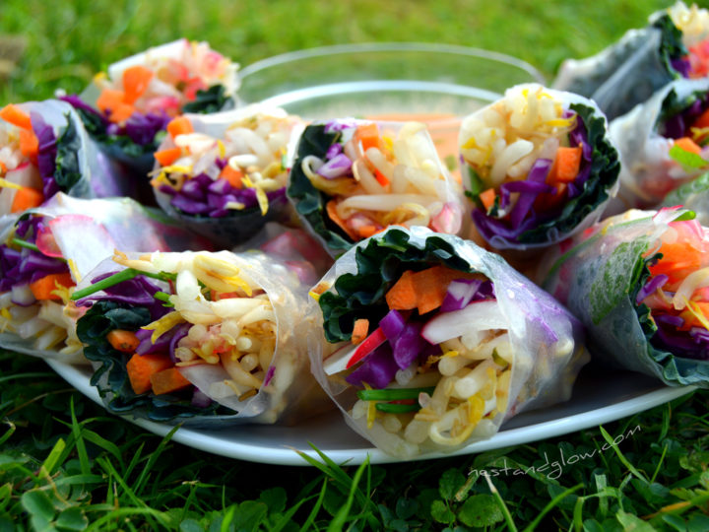
Variations in America
Variations of ingredients:
Examples: fall rolls, winter rolls
Elimination of original ingredients
No herbs, no rice noodles, etc.
Sauce: peanut hoisin sauce is the most common, but many places exclude fish sauce
Generally…
Restaurants in areas with a large Vietnamese population serve more “authentic” versions
whereas those located in areas that cater to a more diverse population make more changes to their recipes
Notes:
Mint, basil, cilantro

Slide 6
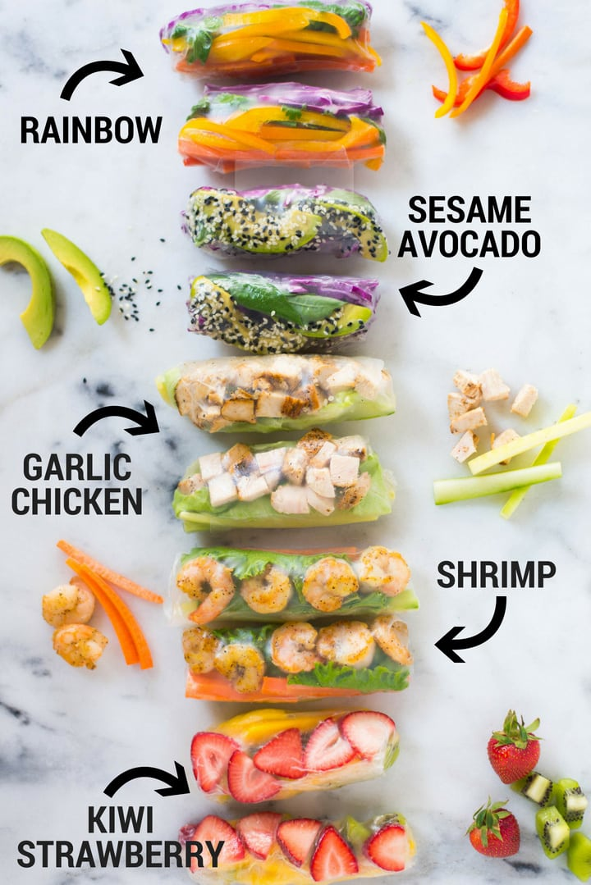
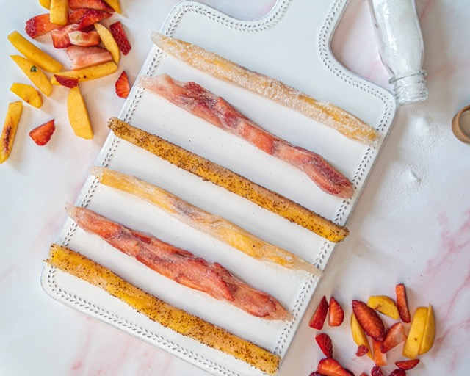
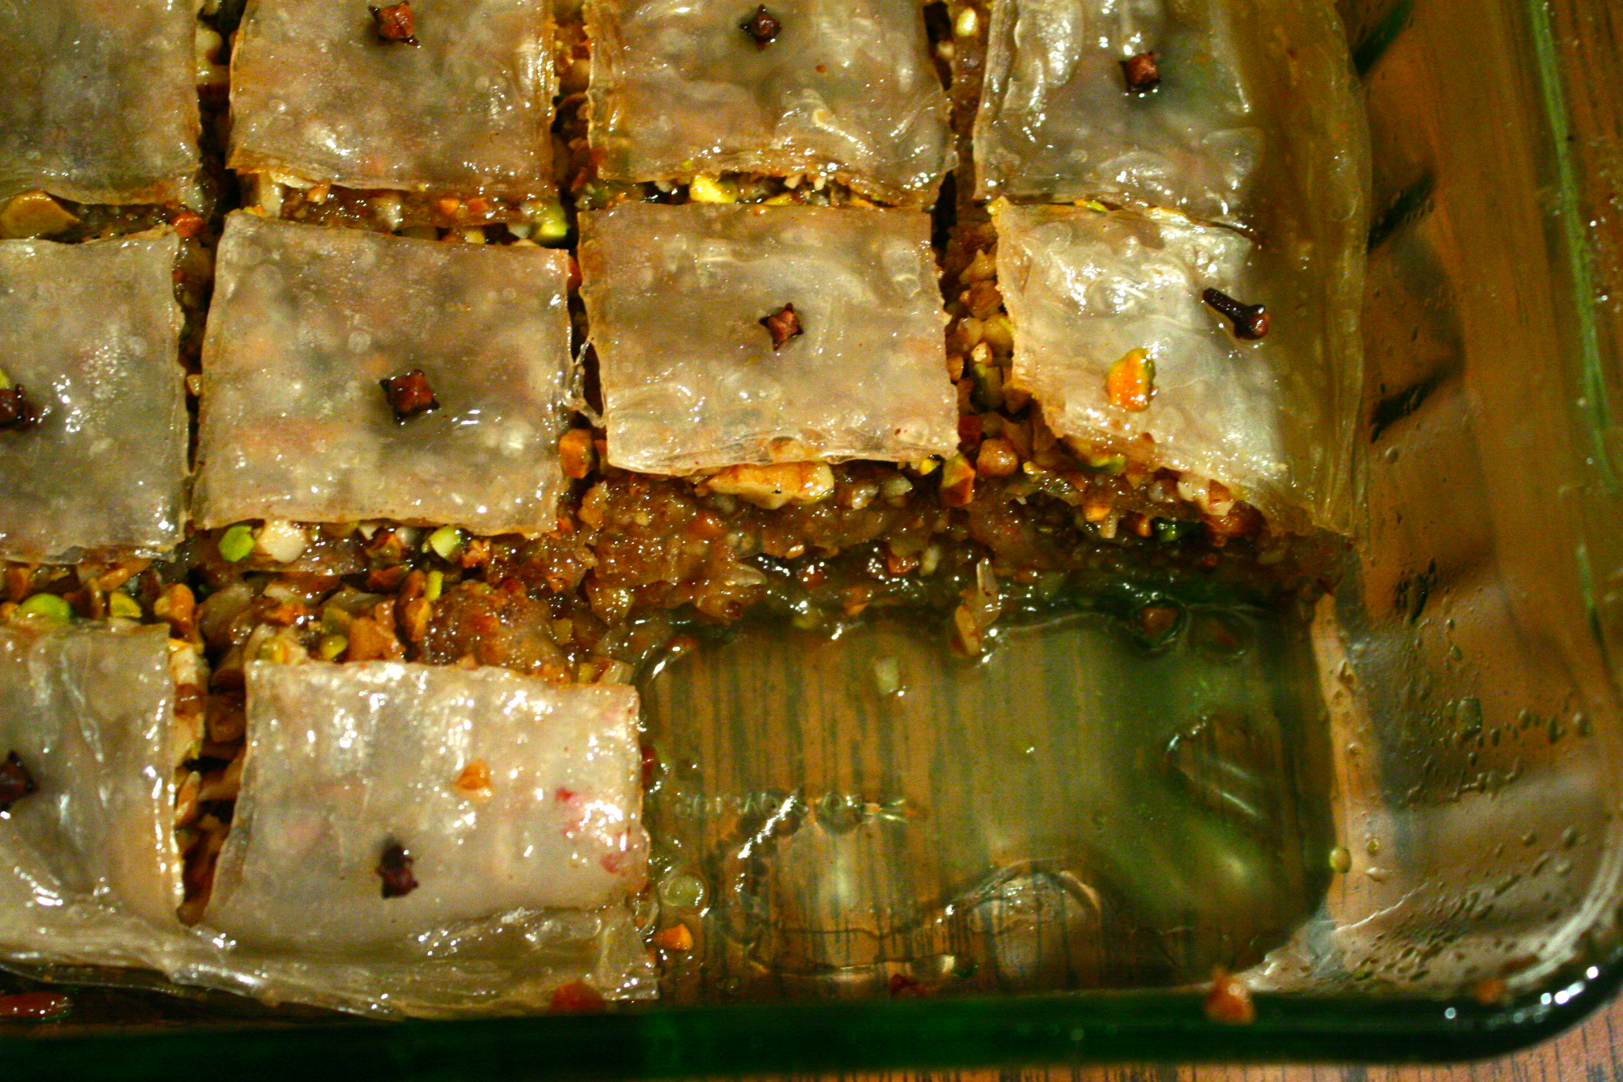
Economic Features
Health Food:
Low calories
Nutritious
Addition of goji berries in sauce (antioxidants)
Rice paper
Versatile
Gluten-free
Healthy

Slide 7
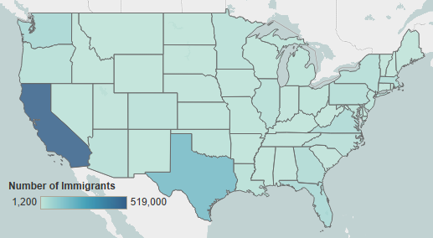
Geographic Position
Since different regions of Vietnam have slightly different foods, the people that settled in different areas of America plays a huge role in the availability of variety in America
Most people settled in California, so they have both Northern and Southern style cuisines, but other parts of the country are less diverse
Overall plenty of Vietnamese restaurants spread throughout America

Slide 8
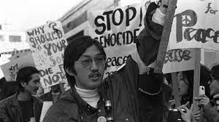
Political Identity
South Vietnamese originally entered the US as political refugees
Support Republican Party
Anti-communist

Slide 9
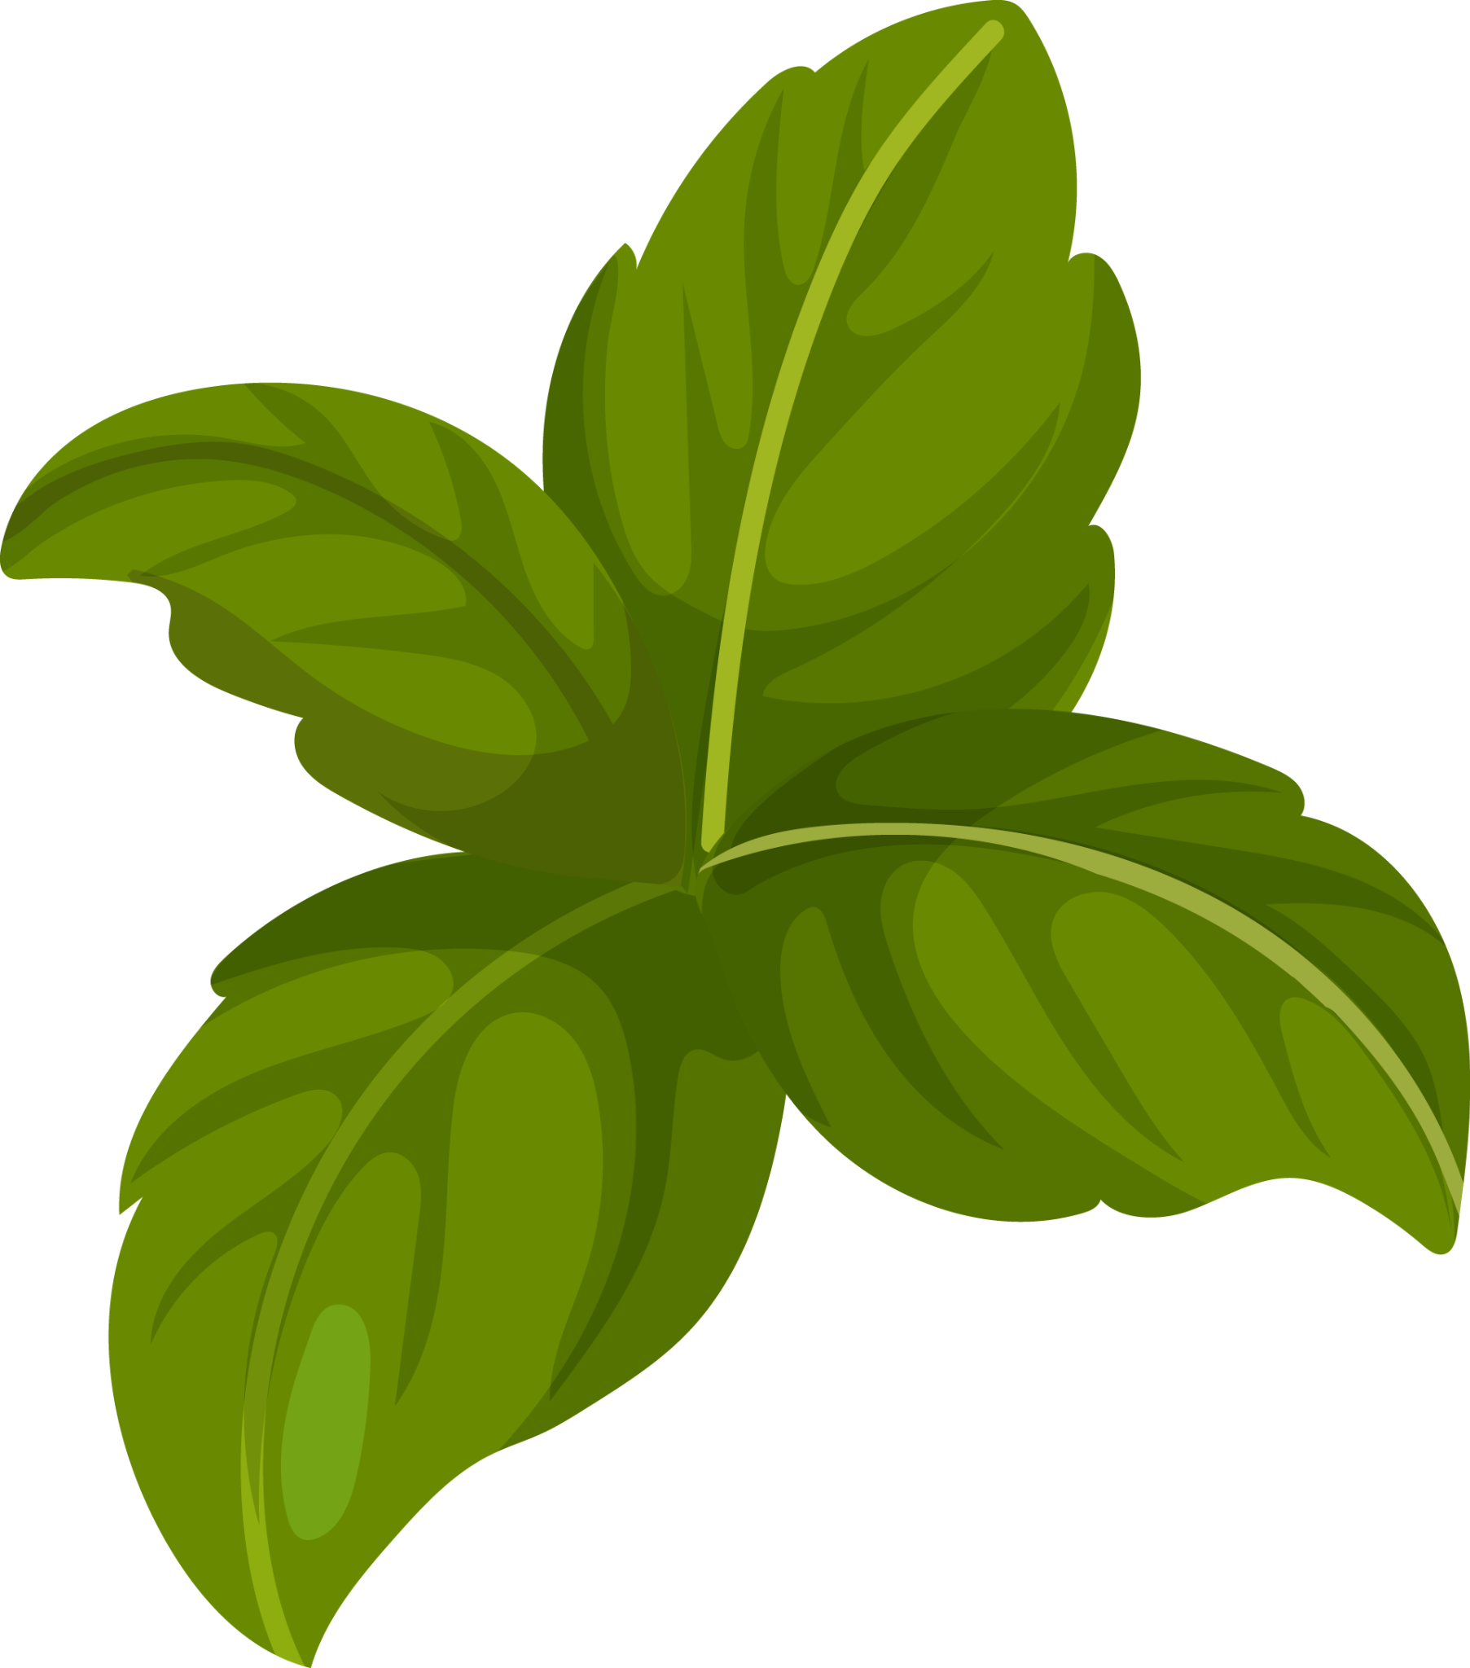
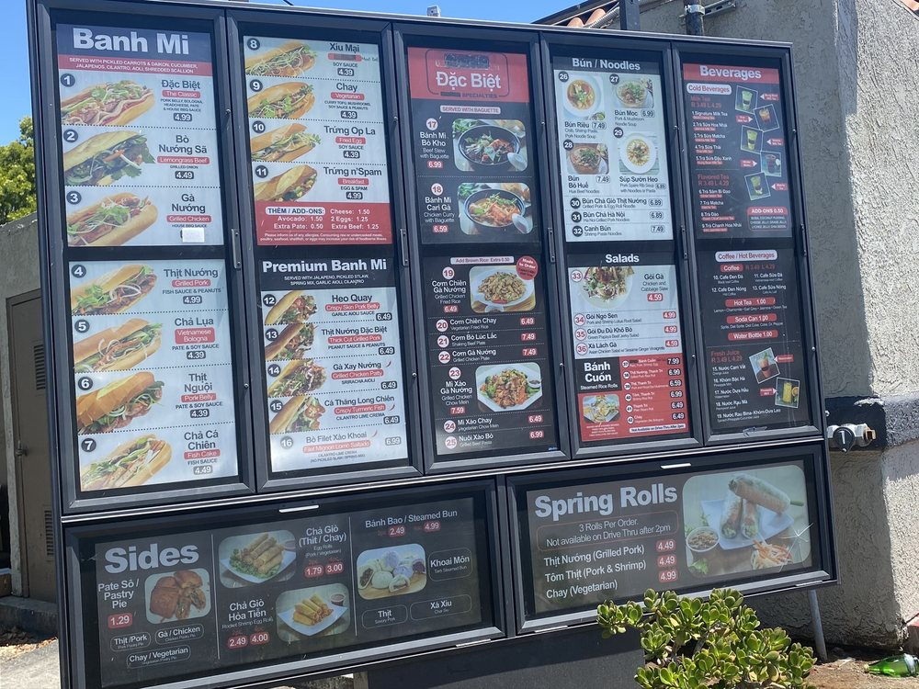
Current Study
During COVID, Vietnamese restaurants began offering drive-thru options
Currently, there are a few of these restaurants in California and Texas, but more are looking to open up
Owners see drive-thrus as a “classic American innovation” that increased the success of fast food in America, hope to use this idea to increase popularity of Vietnamese food
Orange County, California
Notes:
https://menucuisine.com/online-menu/carrot-and-daikon-banh-mi/

Slide 10
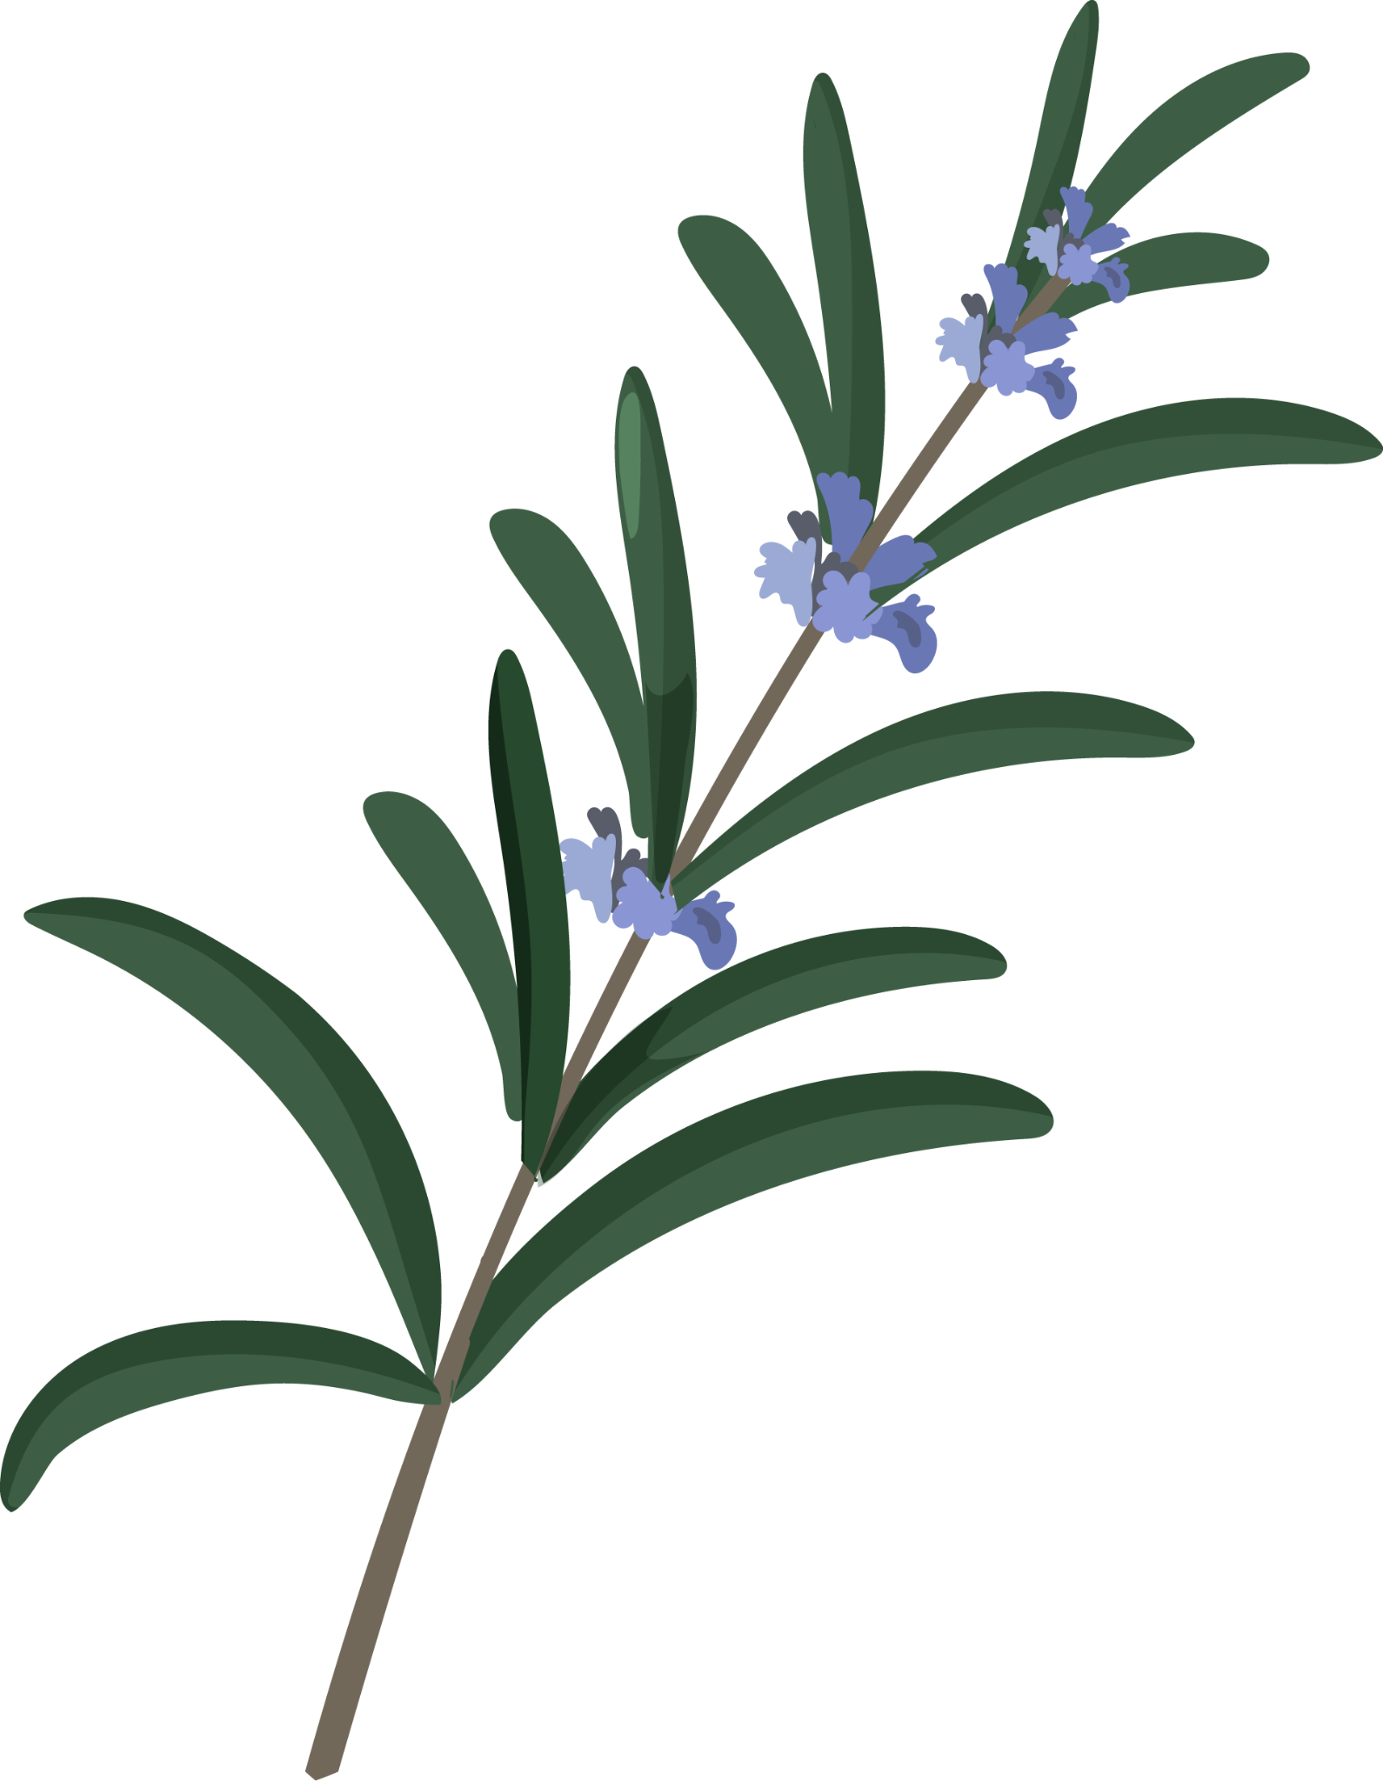
Thank You!

